Slide 1
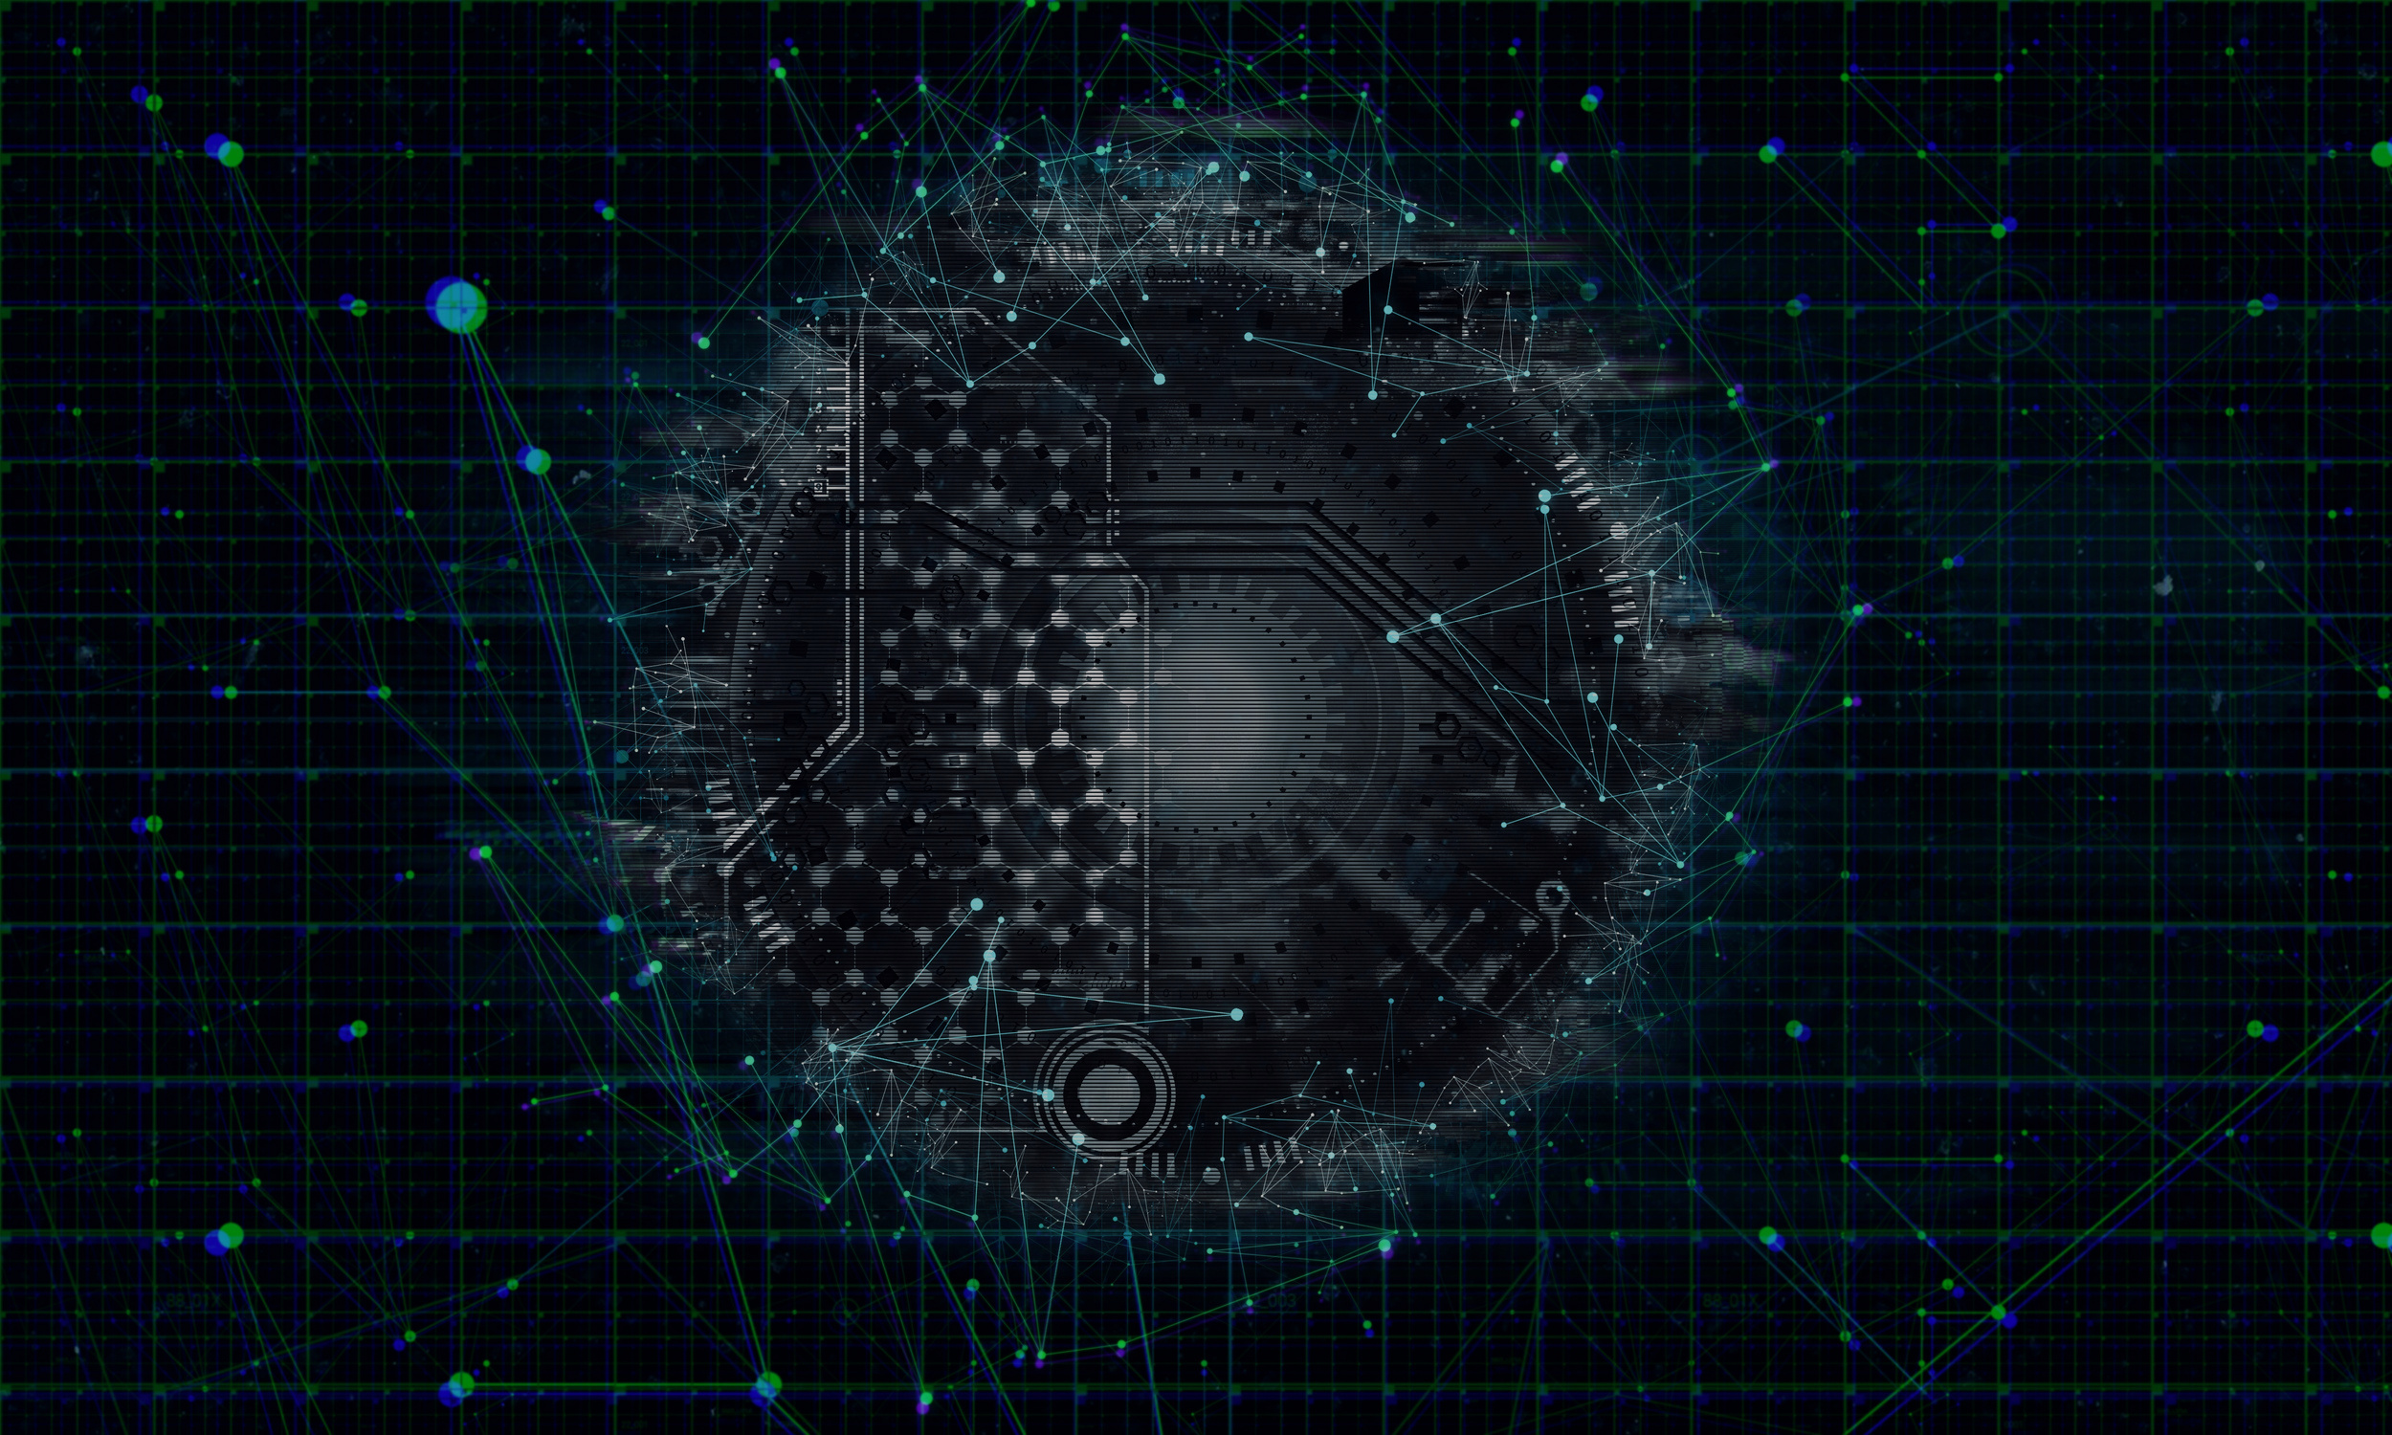
Computer Security
Security Concepts

Slide 2
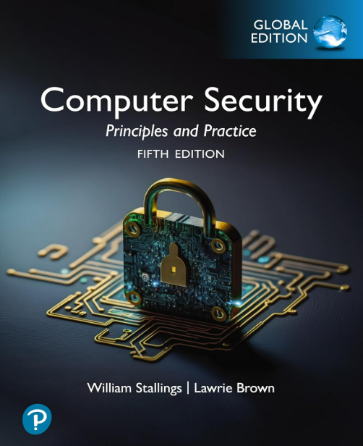
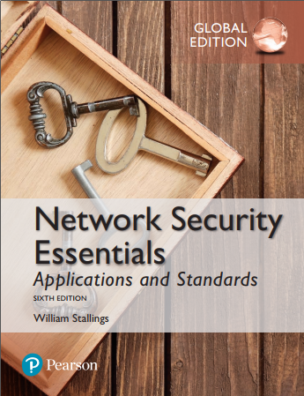

Text Book
Recommended Textbook
Computer Security: Principles and Practice, Global Edition
Ref
Network Security: Private Communication in a Public World
Charlie Kaufman, Rad ia Perlman, Mike Speciner, Michael Speciner, Prentice Hall
Network Security Essentials Applications and Standards- William Stalling-Applications and Standards

Slide 3
Learning Objectives
Describe the key security requirements of confidentiality, integrity, and availability
Discuss the types of security threats and attacks
Summarize the functional requirements for computer security
Describe the X.800 security architecture for OSI
Cryptography applications

Slide 4
Introduction
Humans have been in conflict since prehistoric times.
In The Art of War 1, Sun Tzu says “The entire art of war is based on deception”.

Slide 5
History – Pre-Renaissance
Paper was first introduced to Europe by Crusaders around 1200 A.D.
Information was stored using tokens, tablets, knotted strings, notched sticks or handwritten parchment.

Slide 6
History – Pre-Renaissance
Perhaps the best illustration of the importance of information security to ancient societies is the relatively advanced state of cryptography and steganography, technologies devoted to keeping information secret, when compared to the other technologies available for computing and communication.
Cryptography is the science of writing in codes that are hard to decipher, and steganography is the art of hiding information to make it hard to detect.
In Rome, Julius Caesar used a simple substitution cipher to hide information from his enemies
During Abbasid caliphate [750 A.D], instruction to administrators explained how to use substitution ciphers. Muslim texts of that era explain how frequency counting can easily break substitution ciphers.

Slide 7
History – Pre-Renaissance
Even more effort was devoted to finding tools for steganography. Recorded ancient approaches for information hiding include
Texts written on shaved skulls that were later covered by letting hair grow (Greece),
Invisible inks (Rome),
Pin pricks placed above letters in a text to indicate letters in a secret message (Greece),
Messages hidden in images and hieroglyphics (Egypt), and
Messages written on a thin sheet, rolled into a wax ball, and hidden or swallowed (China).

Slide 8
History – Renaissance to World War I
The Renaissance was a period of renewed intellectual activity in Europe starting in the 14th century.
Napier’s bones used for multiplication, division, and finding square roots [1617]
Blaise Pascal produced around 50 mechanical calculators starting in 1642.
In 1800s Herman Hollerith developed a punch card tabulation system
Charles Babbage produced the first programmable machines, the difference and analytical engines, in the mid-1800s
Poly-alphabetic solution ciphers

Slide 9
History –World War II
During WWII, German cryptographers secured their communications using the Enigma encryption
The Japanese had a cipher device that was their equivalent to Enigma. It was code-named Purple.

Slide 10
History –Cold War
The new availability of computers allowed the science of cryptography to make major advances.
In the United States, the National Security Agency (NSA) is in charge of cryptographic research for the United States government
Cryptography also became available for civilian use.
In the 1970s the U.S. National Bureau of Standards4, with NSA approval, agreed to the release of the Data Encryption Standard (DES) with a 56-bit key-space.
The development of public key cryptography is a major step towards solving the problem of key distribution

Slide 11
History –Cold War
The new availability of computers allowed the science of cryptography to make major advances.
In the United States, the National Security Agency (NSA) is in charge of cryptographic research for the United States government
Cryptography also became available for civilian use.
In the 1970s the U.S. National Bureau of Standards4, with NSA approval, agreed to the release of the Data Encryption Standard (DES) with a 56-bit key-space.
The development of public key cryptography is a major step towards solving the problem of key distribution

Slide 12
History – The Modern Era
Computers!
Examples
  Lucifer
  Rijndael
  RSA
  ElGamal

Slide 13
Organized Crime and Botnets
Current cybercrime technologies and techniques include
botnets – networks of compromised machines,
spam – unsolicited e-mail advertisements, usually fraudulent,
phishing – attempts to fraudulently collect sensitive personal information,
pharming – redirecting web traffic to a fraudulent site,
identity theft and identity fraud – fraudulent use of personal information,
cross site scripting – inserting script commands into another’s website,
cross site request forgery – tricking a user’s browser to making requests on another party’s website, • underground forums, and
money laundering.

Slide 14
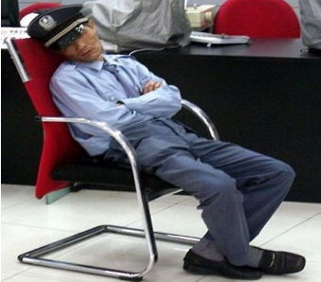

What is Security?
Security according to two boys of 10 years old-

Slide 15

What is Security?
Security According to Junior High School ICT teacher-

Slide 16

What is Security?
There is no clear cut definition.

Slide 17

What is Security?
Security is a process, not an end state

Slide 18
Computer Security Concepts
Before the widespread use of data processing equipment, the security of information valuable to an organization was provided primarily by physical and administrative means
With the introduction of the computer, the need for automated tools for protecting files and other information stored on the computer became evident
Another major change that affected security is the introduction of distributed systems and the use of networks and communications facilities for carrying data between terminal user and computer and between computers

Slide 19
Computer and Internet Security
Computer security
  The generic name for the collection of tools designed to protect data and to thwart hackers
Internet security
  Consists of measures to, deter, prevent, detect and correct security violations that involve the transmission of information

Slide 20
What security is about in general?
Security is about protection of assets
  D. Gollmann, Computer Security, Wiley
  Need
Prevention
  take measures that prevent your assets from being damaged (or stolen)
Detection
  take measures so that you can detect when, how, and by whom an asset has been damaged
Reaction
  take measures so that you can recover your assets

Slide 21
Information security in past & present
Traditional Information Security
  keep the cabinets locked
  put them in a secure room
  human guards
  electronic surveillance systems
  in general: physical and administrative mechanisms
Modern World
  Data are in computers
  Computers are interconnected
  Data/ Computer and Network Security-> Cyber Security
Notes:
Traditionally information security provided by physical (eg. rugged filing cabinets with locks) and administrative mechanisms (eg. Personnel screening procedures during hiring process).
Growing computer use implies a need for automated tools for protecting files and other information stored on it.
This is especially the case for a shared system, such as a time-sharing system, and even more so for systems that can be
accessed over a public telephone network, data network, or the Internet.

Slide 22
Real world example
Prevention
  locks at doors, window bars, secure the walls around the property, hire a guard
Detection
  missing items, burglar alarms, closed circuit TV
Reaction
  attack on burglar (not recommended ☺), call the police, replace stolen items, make an insurance claim

Slide 23
Definition
Cybersecurity is the protection of information that is stored, transmitted, and processed in a networked system of computers, other digital devices, and network devices and transmission lines, including the Internet.
Protection encompasses confidentiality, integrity, availability, authenticity, and accountability.
Methods of protection include organizational policies and procedures, as well as technical means such as encryption and secure communications protocols.
Notes:
Traditionally information security provided by physical (eg. rugged filing cabinets with locks) and administrative mechanisms (eg. Personnel screening procedures during hiring process).
Growing computer use implies a need for automated tools for protecting files and other information stored on it.
This is especially the case for a shared system, such as a time-sharing system, and even more so for systems that can be
accessed over a public telephone network, data network, or the Internet.

Slide 24
Cybersecurity: Categories
Information security: This term refers to preservation of confidentiality, integrity, and availability of information.
  In addition, other properties, such as authenticity, accountability, nonrepudiation, and reliability can also be involved.
Network security: This term refers to
  protection of networks and their service from
  unauthorized modification, destruction, or disclosure, and
  provision of assurance that the network performs its critical functions correctly and
  there are no harmful side effects.
Notes:
Traditionally information security provided by physical (eg. rugged filing cabinets with locks) and administrative mechanisms (eg. Personnel screening procedures during hiring process).
Growing computer use implies a need for automated tools for protecting files and other information stored on it.
This is especially the case for a shared system, such as a time-sharing system, and even more so for systems that can be
accessed over a public telephone network, data network, or the Internet.

Slide 25
Domains of Cybersecurity
Four domains of cybersecurity: a risk-based systems approach to cyber decisions
Zachary A. Collier • Igor Linkov • James H. Lambert
Linkov et al. (2013) discuss how decision-makers require the ability to plan for threats and absorb, recover, and adapt to threats after they occur along the
physical,
information,
cognitive, and
social domains in which these systems exist.
https://link.springer.com/article/10.1007/s10669-013-9484-z
Notes:
Traditionally information security provided by physical (eg. rugged filing cabinets with locks) and administrative mechanisms (eg. Personnel screening procedures during hiring process).
Growing computer use implies a need for automated tools for protecting files and other information stored on it.
This is especially the case for a shared system, such as a time-sharing system, and even more so for systems that can be
accessed over a public telephone network, data network, or the Internet.

Slide 26
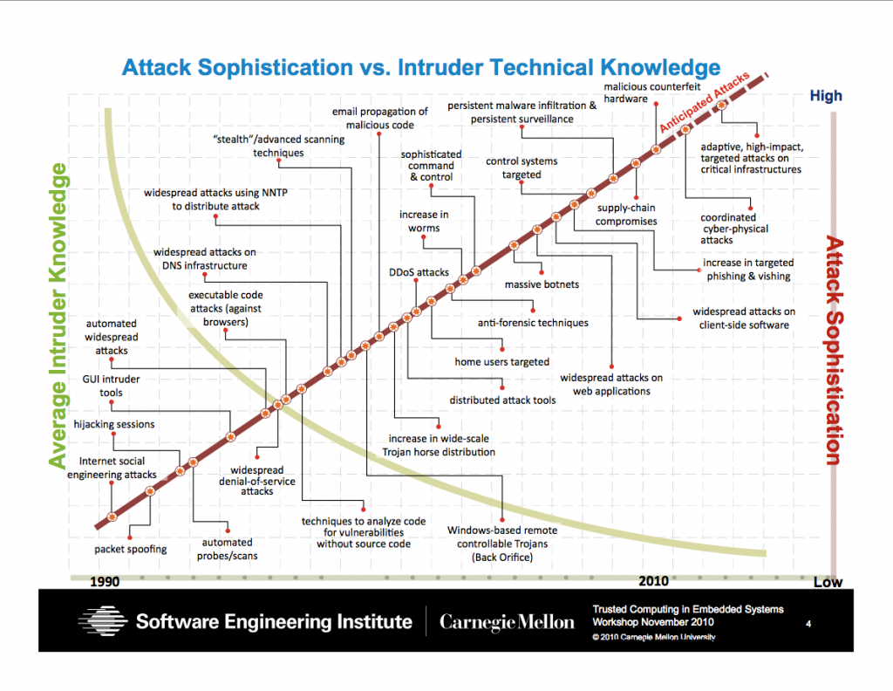
Security Trends
Skill and knowledge required to mount an attack
Notes:
Discussion: Attacks became more sophisticated to find out and more automated so that any kid can mount.

Slide 27
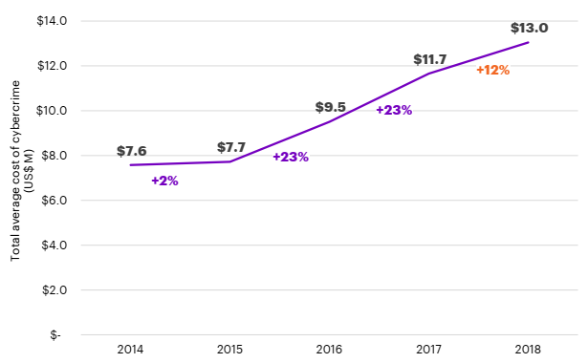
The global average cost of cyber crime/attacks
2018 Cost of Cyber Crime Study by Accenture*
Steeper increasing trend in the recent years
https://www.accenture.com/us-en/insights/security/cost-cybercrime-study

Slide 28
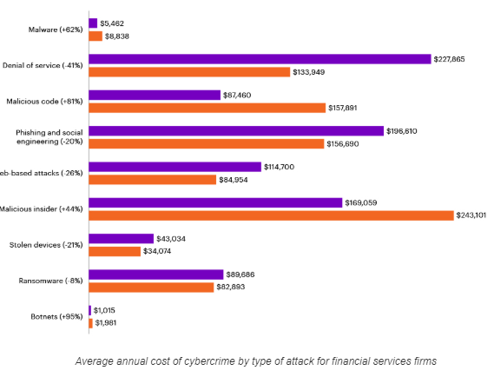
Types of cyber attacks experienced
2018 Cost of Cyber Crime Study by Accenture*
https://www.accenture.com/us-en/insights/security/cost-cybercrime-study

Slide 29
Computer Security

Slide 30

Computer Security
Computer security
  Measures and controls that ensure confidentiality, integrity, and availability of information system assets including hardware, software, firm ware, and information being processed, stored, and communicated.
The NIST Internal/Interagency Report NISTIR 7298 (Glossary of Key Information Security Terms, May 2013) defines the term computer security as follows

Slide 31
Computer Security Objectives
Confidentiality
Data confidentiality
Assures that private or confidential information is not made available or disclosed to unauthorized individuals
Privacy
Assures that individuals control or influence what information related to them may be collected and stored and by whom and to whom that information may be disclosed
Availability
Assures that systems work promptly and service is not denied to authorized users

Slide 32
Integrity
  Data integrity
    Assures that information and programs are changed only in a specified and authorized manner
  System integrity
    Assures that a system performs its intended function in an unimpaired manner, free from deliberate or inadvertent unauthorized manipulation of the system

Slide 33
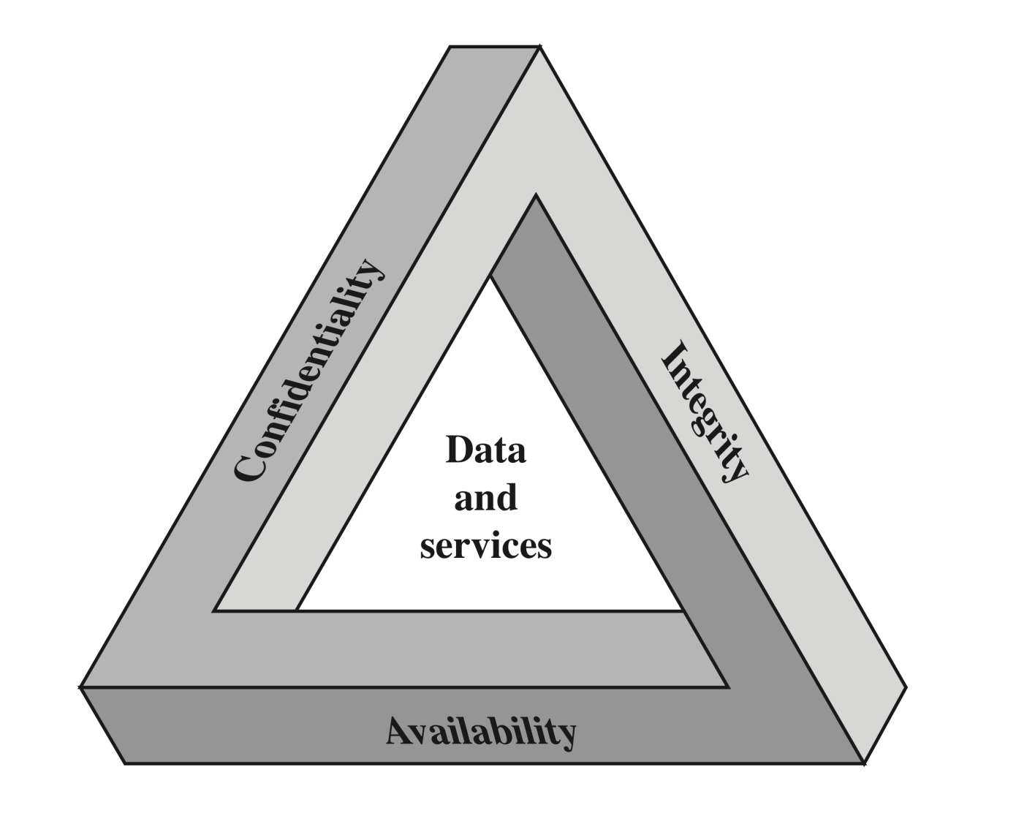
CIA Triad
The Security Requirements Triad

Slide 34
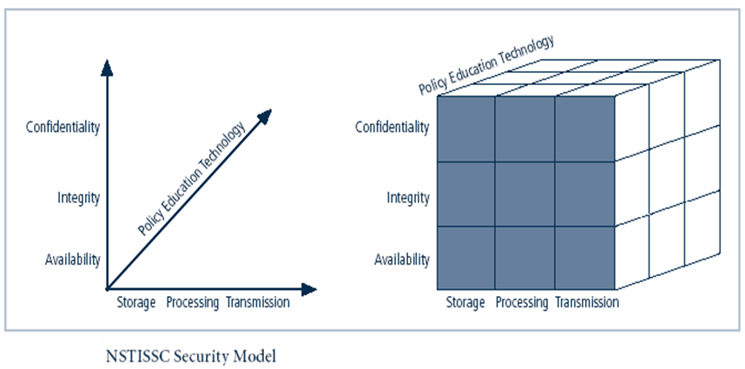
NSTISSC Security Model
‘National Security Telecommunications & Information systems security committee’ document.
It is now called the National Training Standard for Information security professionals.
Notes:
This graphic informs the fundamental approach of the chapter and can be used to illustrate the intersection of information states (x-axis), key objectives of C.I.A. (y-axis), and the three primary means to implement (policy, education, and technology).

Slide 35
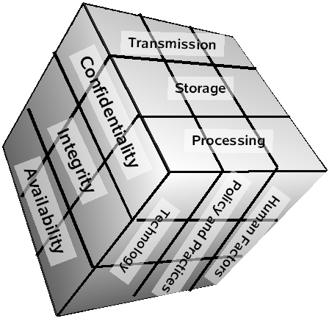
NSTISSC Security Model
What is the McCumber Cube?
Developed by John McCumber in 1991, this model provides a comprehensive framework for evaluating security programs.
Holistic Approach: Independent of specific technology.
3-Dimensional: Identifies 27 critical "cells" of security.
Versatile: Applicable to assessment, design, and evaluation.
Notes:
This graphic informs the fundamental approach of the chapter and can be used to illustrate the intersection of information states (x-axis), key objectives of C.I.A. (y-axis), and the three primary means to implement (policy, education, and technology).

Slide 36
NSTISSC Security Model
The NSTISS model forms a 3 × 3 × 3 cube.
Each cell represents a specific security requirement.
Total of 27 security considerations (3 objectives × 3 states × 3 measures).
Example:
Confidentiality + Transmission + Technology → Encryption of network traffic.
Integrity + Storage + Policy→ Database backup and change-control procedures.
Notes:
This graphic informs the fundamental approach of the chapter and can be used to illustrate the intersection of information states (x-axis), key objectives of C.I.A. (y-axis), and the three primary means to implement (policy, education, and technology).

Slide 37
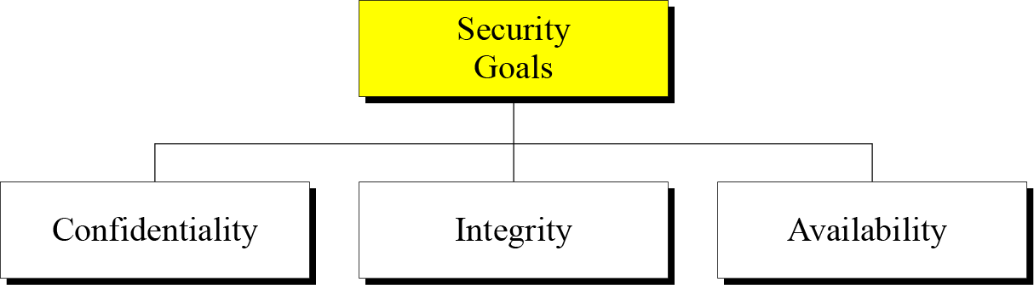

Slide 38
Confidentiality is probably the most common aspect of information security. We need to protect our confidential information. An organization needs to guard against those malicious actions that endanger the confidentiality of its information.
Integrity : Information needs to be changed constantly. Integrity means that changes need to be done only by authorized entities and through authorized mechanisms.
Availability : The information created and stored by an organization needs to be available to authorized entities. Information needs to be constantly changed, which means it must be accessible to authorized entities.

Slide 39
Possible additional concepts:
Authenticity
Verifying that users are who they say they are and that each input arriving at the system came from a trusted source
Accountability
The security goal that generates the requirement for actions of an entity to be traced uniquely to that entity

Slide 40
Possible additional concepts:
Accountability
The security goal that generates the requirement for actions of an entity to be traced uniquely to that entity.
Entity = a user, computer, application, process, or device.
Action = login, file access, data modification, sending an email, deleting a record, etc.
Traced uniquely = there must be evidence showing exactly who or what performed the action.

Slide 41
Possible additional concepts:
Authenticity
The property of being genuine and being able to be verified and trusted; confidence in the validity of a transmission, a message, or message originator. This means verifying that users are who they say they are and that each input arriving at the system came from a trusted source.
This implies that when you receive information, you can verify that:
It has not come from a fake source.
The sender is who they claim to be.
The data has not been forged or impersonated.

Slide 42
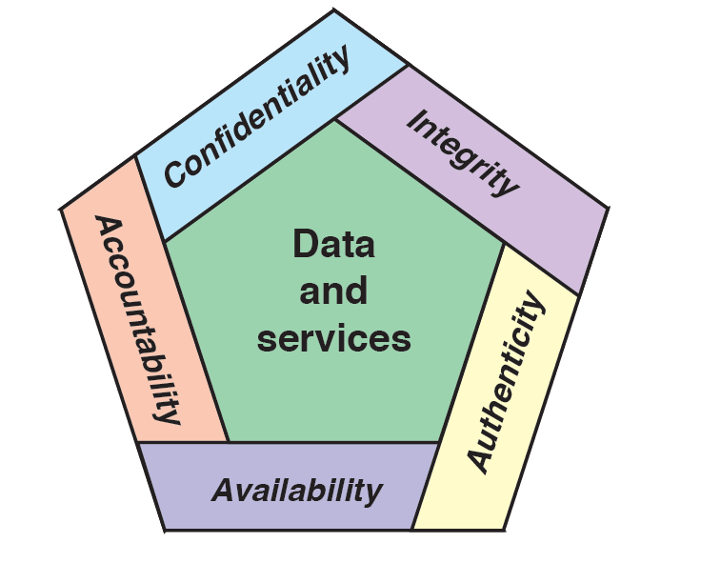
Possible additional concepts:

Slide 43
FIPS 199 Impact Levels of Breach
Example of applications and for each application, the impact of a security breach such as loss of confidentiality, integrity, or availability is evaluated using the three impact levels defined in FIPS 199 will be discussed.
These levels help determine the severity of harm to an organization or individual if a security failure occurs.

Slide 44
Breach of Security : 3 Levels of Impact
High
The loss could be expected to have a severe or catastrophic adverse effect on organizational operations, organizational assets, or individuals
Moderate
The loss could be expected to have a serious adverse effect on organizational operations, organizational assets, or individuals
Low
The loss could be expected to have a limited adverse effect on organizational operations, organizational assets, or individuals

Slide 45
Examples of Security Requirements
Confidentiality
Student grade information is an asset whose confidentiality is considered to be highly important by students
Regulated by the Family Educational Rights and Privacy Act (FERPA)
Integrity
(consistency)
Patient information stored in a database – inaccurate information could result in serious harm or death to a patient and expose the hospital to massive liability
A Web site that offers a forum to registered users to discuss some specific topic would be assigned a moderate level of integrity
An example of a low-integrity requirement is an anonymous online poll
Availability
The more critical a component or service, the higher the level of availability required
A moderate availability requirement is a public Web site for a university
An online telephone directory lookup application would be classified as a low-availability requirement
Notes:
Confidentiality
Student grade information is an asset whose confidentiality is
considered to be highly important by students. In the United States, the release of
such information is regulated by the Family Educational Rights and Privacy Act
(FERPA). Grade information should only be available to students, their parents,
and employees that require the information to do their job. Student enrollment
information may have a moderate confidentiality rating. While still covered by
FERPA, this information is seen by more people on a daily basis, is less likely to be
targeted than grade information, and results in less damage if disclosed. Directory
information (such as lists of students, faculty, or departmental lists) may be assigned
a low confidentiality rating or indeed no rating. This information is typically freely
available to the public and published on a school’s Web site.
Integrity
Several aspects of integrity are illustrated by the example of a hospital
patient’s allergy information stored in a database. The doctor should be able to
trust that the information is correct and current. Now suppose that an employee
(e.g., a nurse) who is authorized to view and update this information deliberately
falsifies the data to cause harm to the hospital. The database needs to be restored
to a trusted basis quickly, and it should be possible to trace the error back to the
person responsible. Patient allergy information is an example of an asset with a high
requirement for integrity. Inaccurate information could result in serious harm or
death to a patient and expose the hospital to massive liability.
An example of an asset that may be assigned a moderate level of integrity
requirement is a Web site that offers a forum to registered users to discuss some
specific topic. Either a registered user or a hacker could falsify some entries or deface
the Web site. If the forum exists only for the enjoyment of the users, brings
in little or no advertising revenue, and is not used for something important such
as research, then potential damage is not severe. The Web master may experience
some data, financial, and time loss.
An example of a low-integrity requirement is an anonymous online poll. Many
Web sites, such as news organizations, offer these polls to their users with very few
safeguards. However, the inaccuracy and unscientific nature of such polls are well
understood.
Availability
The more critical a component or service, the higher is the level of
availability required. Consider a system that provides authentication services for
critical systems, applications, and devices. An interruption of service results in the
inability for customers to access computing resources and for the staff to access
the resources they need to perform critical tasks. The loss of the service translates
into a large financial loss due to lost employee productivity and potential
customer loss.
An example of an asset that typically would be rated as having a moderate
availability requirement is a public Web site for a university; the Web site provides
information for current and prospective students and donors. Such a site is not a
critical component of the university’s information system, but its unavailability will
cause some embarrassment.
An online telephone directory lookup application would be classified as a low availability
requirement. Although the temporary loss of the application may be
an annoyance, there are other ways to access the information, such as a hardcopy
directory or the operator.

Slide 46

Computer Security Challenges
Security is not simple
Potential attacks on the security features need to be considered
Procedures used to provide particular services are often counter-intuitive
It is necessary to decide where to use the various security mechanisms
Requires constant monitoring
Is too often an afterthought
Security mechanisms typically involve more than a particular algorithm or protocol
Security is essentially a battle of wits between a perpetrator and the designer
Little benefit from security investment is perceived until a security failure occurs
Strong security is often viewed as an impediment to efficient and user-friendly operation
Notes:
Computer and network security is both fascinating and complex. Some of the reasons
include:
1. Security is not as simple as it might first appear to the novice. The requirements
seem to be straightforward; indeed, most of the major requirements for
security services can be given self-explanatory, one-word labels: confidentiality,
authentication, nonrepudiation, and integrity. But the mechanisms used to
meet those requirements can be quite complex, and understanding them may
involve rather subtle reasoning.
2. In developing a particular security mechanism or algorithm, one must always
consider potential attacks on those security features. In many cases, successful
attacks are designed by looking at the problem in a completely different way,
therefore exploiting an unexpected weakness in the mechanism.
3. Because of point 2, the procedures used to provide particular services are
often counterintuitive. Typically, a security mechanism is complex, and it is not
obvious from the statement of a particular requirement that such elaborate
measures are needed. It is only when the various aspects of the threat are considered
that elaborate security mechanisms make sense.
4. Having designed various security mechanisms, it is necessary to decide where
to use them. This is true both in terms of physical placement (e.g., at what points
in a network are certain security mechanisms needed) and in a logical sense
[e.g., at what layer or layers of an architecture such as TCP/IP (Transmission
Control Protocol/Internet Protocol) should mechanisms be placed].
5. Security mechanisms typically involve more than a particular algorithm or
protocol. They also require that participants be in possession of some secret information
(e.g., an encryption key), which raises questions about the creation,
distribution, and protection of that secret information. There also may be a reliance
on communications protocols whose behavior may complicate the task
of developing the security mechanism. For example, if the proper functioning
of the security mechanism requires setting time limits on the transit time of a
message from sender to receiver, then any protocol or network that introduces
variable, unpredictable delays may render such time limits meaningless.
6. Computer and network security is essentially a battle of wits between a perpetrator
who tries to find holes and the designer or administrator who tries to
close them. The great advantage that the attacker has is that he or she need
only find a single weakness, while the designer must find and eliminate all
weaknesses to achieve perfect security.
7. There is a natural tendency on the part of users and system managers to
perceive little benefit from security investment until a security failure occurs.
8. Security requires regular, even constant, monitoring, and this is difficult in
today’s short-term, overloaded environment.
9. Security is still too often an afterthought to be incorporated into a system after
the design is complete rather than being an integral part of the design process.
10. Many users (and even security administrators) view strong security as an
impediment to efficient and user-friendly operation of an information
system or use of information.
The difficulties just enumerated will be encountered in numerous ways as we
examine the various security threats and mechanisms throughout this book.

Slide 47
A Model for Computer Security

Slide 48
Vulnerabilities, Threats, and Attacks
Vulnerabilities
Corrupted – Loss of integrity
Leaky – Loss of confidentiality
Unavailable or Very Slow – Loss of availability
Threats
Capable of exploiting vulnerabilities
Represent potential security harm to assets
Attacks (Threats Carried Out)
Passive Attack: Attempts to obtain information without affecting system resources
Active Attack: Attempts to modify system resources or disrupt operations
Insider Attack: Initiated by an entity within the security boundary
Outsider Attack: Initiated from outside the security boundary
Vulnerability → Threat → Attack
Notes:
Computer and network security is both fascinating and complex. Some of the reasons
include:
1. Security is not as simple as it might first appear to the novice. The requirements
seem to be straightforward; indeed, most of the major requirements for
security services can be given self-explanatory, one-word labels: confidentiality,
authentication, nonrepudiation, and integrity. But the mechanisms used to
meet those requirements can be quite complex, and understanding them may
involve rather subtle reasoning.
2. In developing a particular security mechanism or algorithm, one must always
consider potential attacks on those security features. In many cases, successful
attacks are designed by looking at the problem in a completely different way,
therefore exploiting an unexpected weakness in the mechanism.
3. Because of point 2, the procedures used to provide particular services are
often counterintuitive. Typically, a security mechanism is complex, and it is not
obvious from the statement of a particular requirement that such elaborate
measures are needed. It is only when the various aspects of the threat are considered
that elaborate security mechanisms make sense.
4. Having designed various security mechanisms, it is necessary to decide where
to use them. This is true both in terms of physical placement (e.g., at what points
in a network are certain security mechanisms needed) and in a logical sense
[e.g., at what layer or layers of an architecture such as TCP/IP (Transmission
Control Protocol/Internet Protocol) should mechanisms be placed].
5. Security mechanisms typically involve more than a particular algorithm or
protocol. They also require that participants be in possession of some secret information
(e.g., an encryption key), which raises questions about the creation,
distribution, and protection of that secret information. There also may be a reliance
on communications protocols whose behavior may complicate the task
of developing the security mechanism. For example, if the proper functioning
of the security mechanism requires setting time limits on the transit time of a
message from sender to receiver, then any protocol or network that introduces
variable, unpredictable delays may render such time limits meaningless.
6. Computer and network security is essentially a battle of wits between a perpetrator
who tries to find holes and the designer or administrator who tries to
close them. The great advantage that the attacker has is that he or she need
only find a single weakness, while the designer must find and eliminate all
weaknesses to achieve perfect security.
7. There is a natural tendency on the part of users and system managers to
perceive little benefit from security investment until a security failure occurs.
8. Security requires regular, even constant, monitoring, and this is difficult in
today’s short-term, overloaded environment.
9. Security is still too often an afterthought to be incorporated into a system after
the design is complete rather than being an integral part of the design process.
10. Many users (and even security administrators) view strong security as an
impediment to efficient and user-friendly operation of an information
system or use of information.
The difficulties just enumerated will be encountered in numerous ways as we
examine the various security threats and mechanisms throughout this book.

Slide 49
A Model for Computer Security
Relationship Framework
The model defines the interactions between four key components:
Assets: Hardware, software, and data that require protection.
Vulnerabilities: Weaknesses in the system.
Threats: Potential for a security violation.
Countermeasures: Means to mitigate threats.
Notes:
Computer and network security is both fascinating and complex. Some of the reasons
include:
1. Security is not as simple as it might first appear to the novice. The requirements
seem to be straightforward; indeed, most of the major requirements for
security services can be given self-explanatory, one-word labels: confidentiality,
authentication, nonrepudiation, and integrity. But the mechanisms used to
meet those requirements can be quite complex, and understanding them may
involve rather subtle reasoning.
2. In developing a particular security mechanism or algorithm, one must always
consider potential attacks on those security features. In many cases, successful
attacks are designed by looking at the problem in a completely different way,
therefore exploiting an unexpected weakness in the mechanism.
3. Because of point 2, the procedures used to provide particular services are
often counterintuitive. Typically, a security mechanism is complex, and it is not
obvious from the statement of a particular requirement that such elaborate
measures are needed. It is only when the various aspects of the threat are considered
that elaborate security mechanisms make sense.
4. Having designed various security mechanisms, it is necessary to decide where
to use them. This is true both in terms of physical placement (e.g., at what points
in a network are certain security mechanisms needed) and in a logical sense
[e.g., at what layer or layers of an architecture such as TCP/IP (Transmission
Control Protocol/Internet Protocol) should mechanisms be placed].
5. Security mechanisms typically involve more than a particular algorithm or
protocol. They also require that participants be in possession of some secret information
(e.g., an encryption key), which raises questions about the creation,
distribution, and protection of that secret information. There also may be a reliance
on communications protocols whose behavior may complicate the task
of developing the security mechanism. For example, if the proper functioning
of the security mechanism requires setting time limits on the transit time of a
message from sender to receiver, then any protocol or network that introduces
variable, unpredictable delays may render such time limits meaningless.
6. Computer and network security is essentially a battle of wits between a perpetrator
who tries to find holes and the designer or administrator who tries to
close them. The great advantage that the attacker has is that he or she need
only find a single weakness, while the designer must find and eliminate all
weaknesses to achieve perfect security.
7. There is a natural tendency on the part of users and system managers to
perceive little benefit from security investment until a security failure occurs.
8. Security requires regular, even constant, monitoring, and this is difficult in
today’s short-term, overloaded environment.
9. Security is still too often an afterthought to be incorporated into a system after
the design is complete rather than being an integral part of the design process.
10. Many users (and even security administrators) view strong security as an
impediment to efficient and user-friendly operation of an information
system or use of information.
The difficulties just enumerated will be encountered in numerous ways as we
examine the various security threats and mechanisms throughout this book.

Slide 50
A Model for Computer Security
Relationship Framework
The model defines the interactions between four key components:
Assets: Hardware, software, and data that require protection.
Vulnerabilities: Weaknesses in the system.
Threats: Potential for a security violation.
Countermeasures: Means to mitigate threats.
Notes:
Computer and network security is both fascinating and complex. Some of the reasons
include:
1. Security is not as simple as it might first appear to the novice. The requirements
seem to be straightforward; indeed, most of the major requirements for
security services can be given self-explanatory, one-word labels: confidentiality,
authentication, nonrepudiation, and integrity. But the mechanisms used to
meet those requirements can be quite complex, and understanding them may
involve rather subtle reasoning.
2. In developing a particular security mechanism or algorithm, one must always
consider potential attacks on those security features. In many cases, successful
attacks are designed by looking at the problem in a completely different way,
therefore exploiting an unexpected weakness in the mechanism.
3. Because of point 2, the procedures used to provide particular services are
often counterintuitive. Typically, a security mechanism is complex, and it is not
obvious from the statement of a particular requirement that such elaborate
measures are needed. It is only when the various aspects of the threat are considered
that elaborate security mechanisms make sense.
4. Having designed various security mechanisms, it is necessary to decide where
to use them. This is true both in terms of physical placement (e.g., at what points
in a network are certain security mechanisms needed) and in a logical sense
[e.g., at what layer or layers of an architecture such as TCP/IP (Transmission
Control Protocol/Internet Protocol) should mechanisms be placed].
5. Security mechanisms typically involve more than a particular algorithm or
protocol. They also require that participants be in possession of some secret information
(e.g., an encryption key), which raises questions about the creation,
distribution, and protection of that secret information. There also may be a reliance
on communications protocols whose behavior may complicate the task
of developing the security mechanism. For example, if the proper functioning
of the security mechanism requires setting time limits on the transit time of a
message from sender to receiver, then any protocol or network that introduces
variable, unpredictable delays may render such time limits meaningless.
6. Computer and network security is essentially a battle of wits between a perpetrator
who tries to find holes and the designer or administrator who tries to
close them. The great advantage that the attacker has is that he or she need
only find a single weakness, while the designer must find and eliminate all
weaknesses to achieve perfect security.
7. There is a natural tendency on the part of users and system managers to
perceive little benefit from security investment until a security failure occurs.
8. Security requires regular, even constant, monitoring, and this is difficult in
today’s short-term, overloaded environment.
9. Security is still too often an afterthought to be incorporated into a system after
the design is complete rather than being an integral part of the design process.
10. Many users (and even security administrators) view strong security as an
impediment to efficient and user-friendly operation of an information
system or use of information.
The difficulties just enumerated will be encountered in numerous ways as we
examine the various security threats and mechanisms throughout this book.

Slide 51
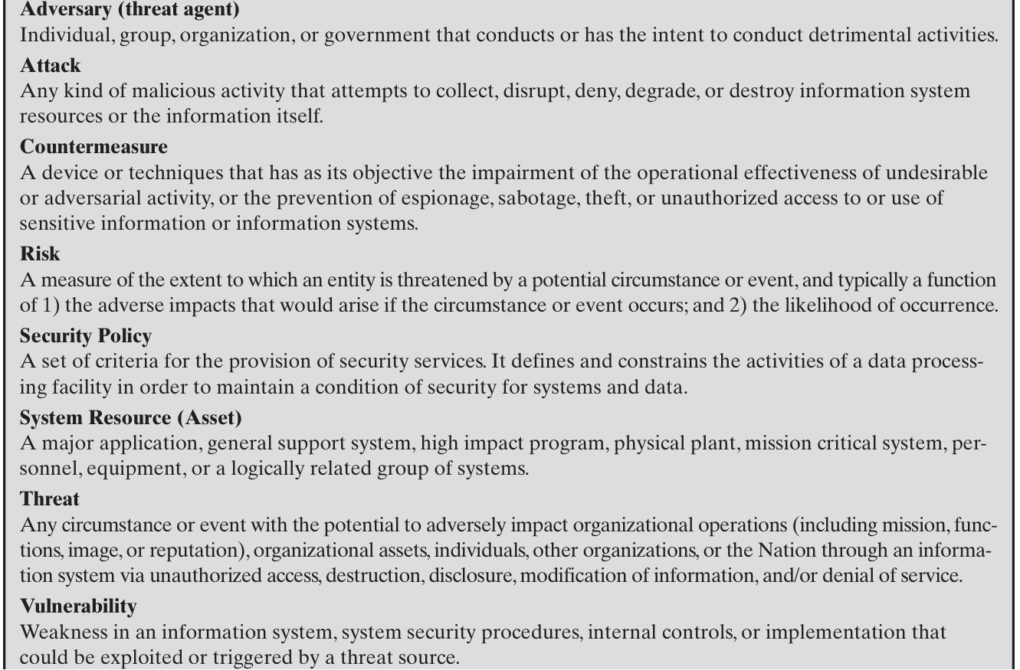
Computer Security Terminologies

Slide 52
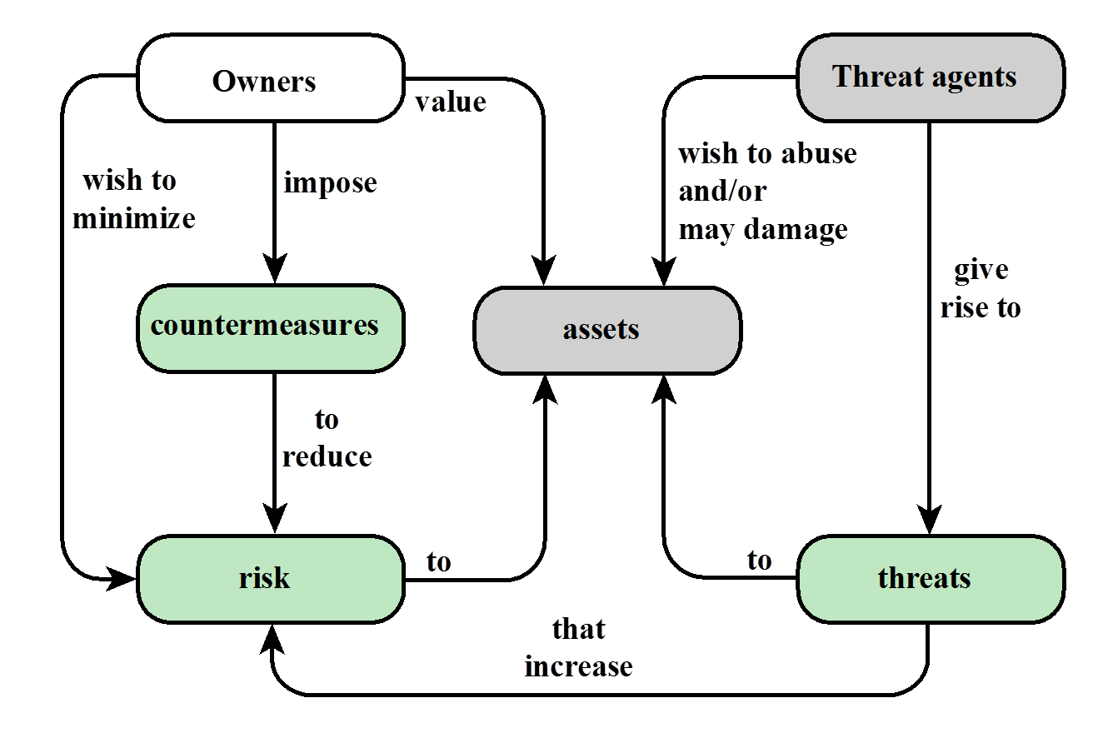
Relationships among the security Concepts

Slide 53
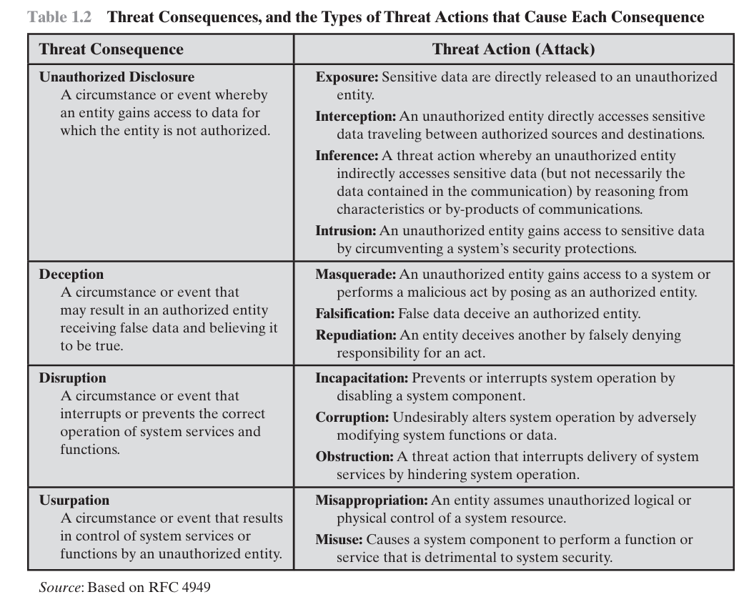
Threat Consequences
Notes:
Computer and network security is both fascinating and complex. Some of the reasons
include:
1. Security is not as simple as it might first appear to the novice. The requirements
seem to be straightforward; indeed, most of the major requirements for
security services can be given self-explanatory, one-word labels: confidentiality,
authentication, nonrepudiation, and integrity. But the mechanisms used to
meet those requirements can be quite complex, and understanding them may
involve rather subtle reasoning.
2. In developing a particular security mechanism or algorithm, one must always
consider potential attacks on those security features. In many cases, successful
attacks are designed by looking at the problem in a completely different way,
therefore exploiting an unexpected weakness in the mechanism.
3. Because of point 2, the procedures used to provide particular services are
often counterintuitive. Typically, a security mechanism is complex, and it is not
obvious from the statement of a particular requirement that such elaborate
measures are needed. It is only when the various aspects of the threat are considered
that elaborate security mechanisms make sense.
4. Having designed various security mechanisms, it is necessary to decide where
to use them. This is true both in terms of physical placement (e.g., at what points
in a network are certain security mechanisms needed) and in a logical sense
[e.g., at what layer or layers of an architecture such as TCP/IP (Transmission
Control Protocol/Internet Protocol) should mechanisms be placed].
5. Security mechanisms typically involve more than a particular algorithm or
protocol. They also require that participants be in possession of some secret information
(e.g., an encryption key), which raises questions about the creation,
distribution, and protection of that secret information. There also may be a reliance
on communications protocols whose behavior may complicate the task
of developing the security mechanism. For example, if the proper functioning
of the security mechanism requires setting time limits on the transit time of a
message from sender to receiver, then any protocol or network that introduces
variable, unpredictable delays may render such time limits meaningless.
6. Computer and network security is essentially a battle of wits between a perpetrator
who tries to find holes and the designer or administrator who tries to
close them. The great advantage that the attacker has is that he or she need
only find a single weakness, while the designer must find and eliminate all
weaknesses to achieve perfect security.
7. There is a natural tendency on the part of users and system managers to
perceive little benefit from security investment until a security failure occurs.
8. Security requires regular, even constant, monitoring, and this is difficult in
today’s short-term, overloaded environment.
9. Security is still too often an afterthought to be incorporated into a system after
the design is complete rather than being an integral part of the design process.
10. Many users (and even security administrators) view strong security as an
impediment to efficient and user-friendly operation of an information
system or use of information.
The difficulties just enumerated will be encountered in numerous ways as we
examine the various security threats and mechanisms throughout this book.

Slide 54
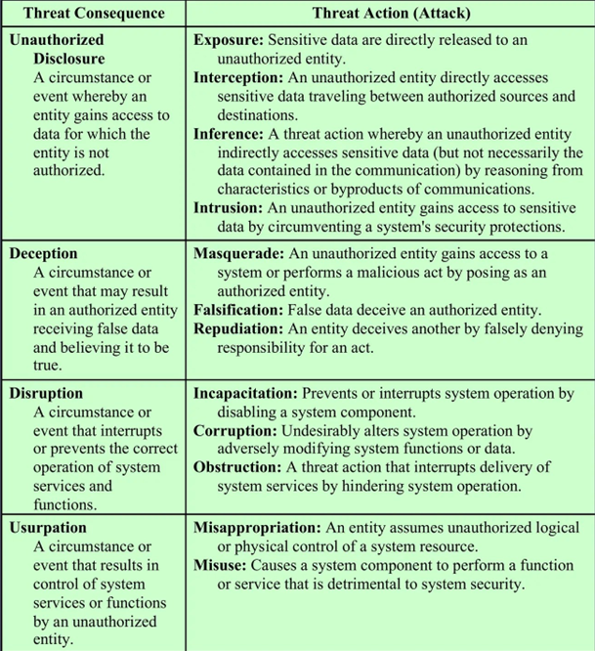
Threat Consequences
Table 1.2 Threat Consequences, and the Types of Threat Actions that Cause Each Consequence
Notes:
Computer and network security is both fascinating and complex. Some of the reasons
include:
1. Security is not as simple as it might first appear to the novice. The requirements
seem to be straightforward; indeed, most of the major requirements for
security services can be given self-explanatory, one-word labels: confidentiality,
authentication, nonrepudiation, and integrity. But the mechanisms used to
meet those requirements can be quite complex, and understanding them may
involve rather subtle reasoning.
2. In developing a particular security mechanism or algorithm, one must always
consider potential attacks on those security features. In many cases, successful
attacks are designed by looking at the problem in a completely different way,
therefore exploiting an unexpected weakness in the mechanism.
3. Because of point 2, the procedures used to provide particular services are
often counterintuitive. Typically, a security mechanism is complex, and it is not
obvious from the statement of a particular requirement that such elaborate
measures are needed. It is only when the various aspects of the threat are considered
that elaborate security mechanisms make sense.
4. Having designed various security mechanisms, it is necessary to decide where
to use them. This is true both in terms of physical placement (e.g., at what points
in a network are certain security mechanisms needed) and in a logical sense
[e.g., at what layer or layers of an architecture such as TCP/IP (Transmission
Control Protocol/Internet Protocol) should mechanisms be placed].
5. Security mechanisms typically involve more than a particular algorithm or
protocol. They also require that participants be in possession of some secret information
(e.g., an encryption key), which raises questions about the creation,
distribution, and protection of that secret information. There also may be a reliance
on communications protocols whose behavior may complicate the task
of developing the security mechanism. For example, if the proper functioning
of the security mechanism requires setting time limits on the transit time of a
message from sender to receiver, then any protocol or network that introduces
variable, unpredictable delays may render such time limits meaningless.
6. Computer and network security is essentially a battle of wits between a perpetrator
who tries to find holes and the designer or administrator who tries to
close them. The great advantage that the attacker has is that he or she need
only find a single weakness, while the designer must find and eliminate all
weaknesses to achieve perfect security.
7. There is a natural tendency on the part of users and system managers to
perceive little benefit from security investment until a security failure occurs.
8. Security requires regular, even constant, monitoring, and this is difficult in
today’s short-term, overloaded environment.
9. Security is still too often an afterthought to be incorporated into a system after
the design is complete rather than being an integral part of the design process.
10. Many users (and even security administrators) view strong security as an
impediment to efficient and user-friendly operation of an information
system or use of information.
The difficulties just enumerated will be encountered in numerous ways as we
examine the various security threats and mechanisms throughout this book.

Slide 55
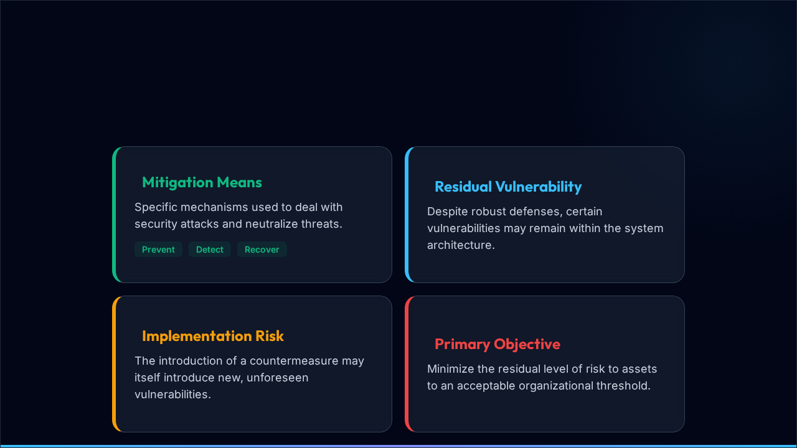
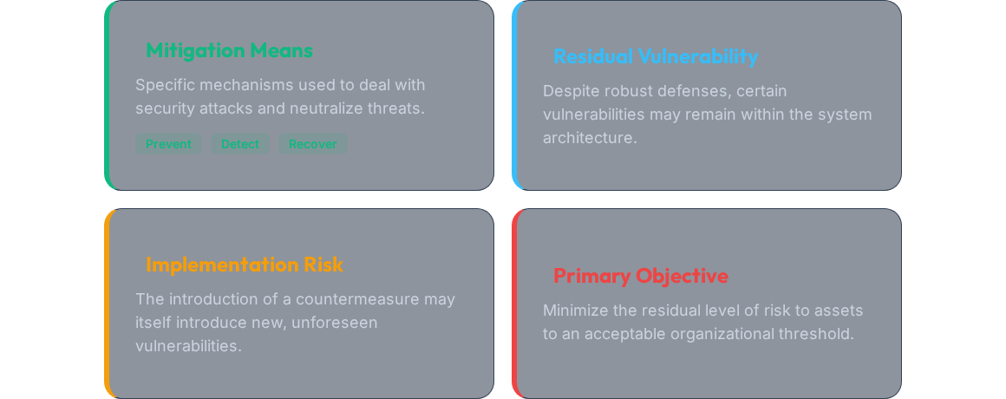


Countermeasures
THE LIFECYCLE OF SECURITY MITIGATION & RESIDUAL RISK
Computer Security: Principles and Practice | Stallings

Slide 56



System Assets Detailed
Hardware
Software
Data
Network
Physical devices, processors, and storage media. Threats: Theft, destruction, and sabotage.
OS, utilities, and applications. Threats: Deletion, alteration, or unauthorized copying.
Files, DBs, and sensitive info. Primary target of disclosure and corruption attacks.
Communication lines and switches. Vulnerable to interception and DoS.

Slide 57
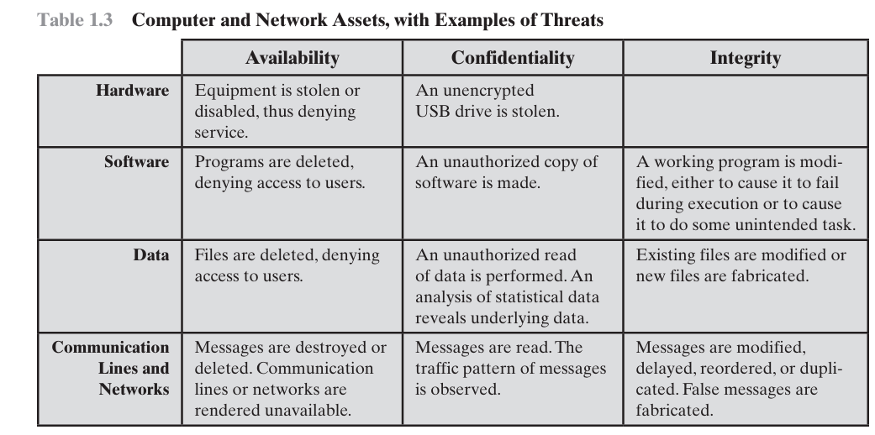
System Assets and Threats

Slide 58
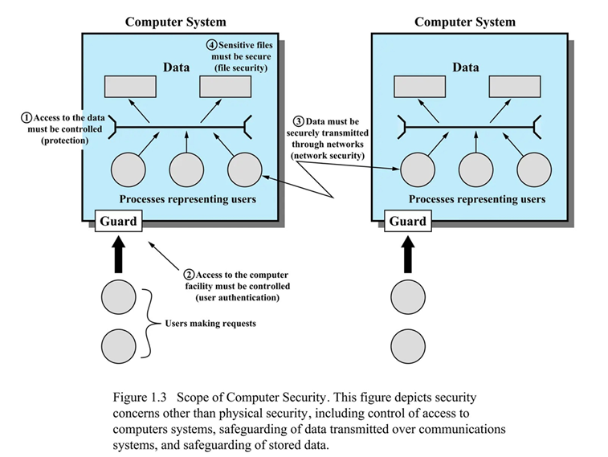
System Assets and Security Scope

Slide 59
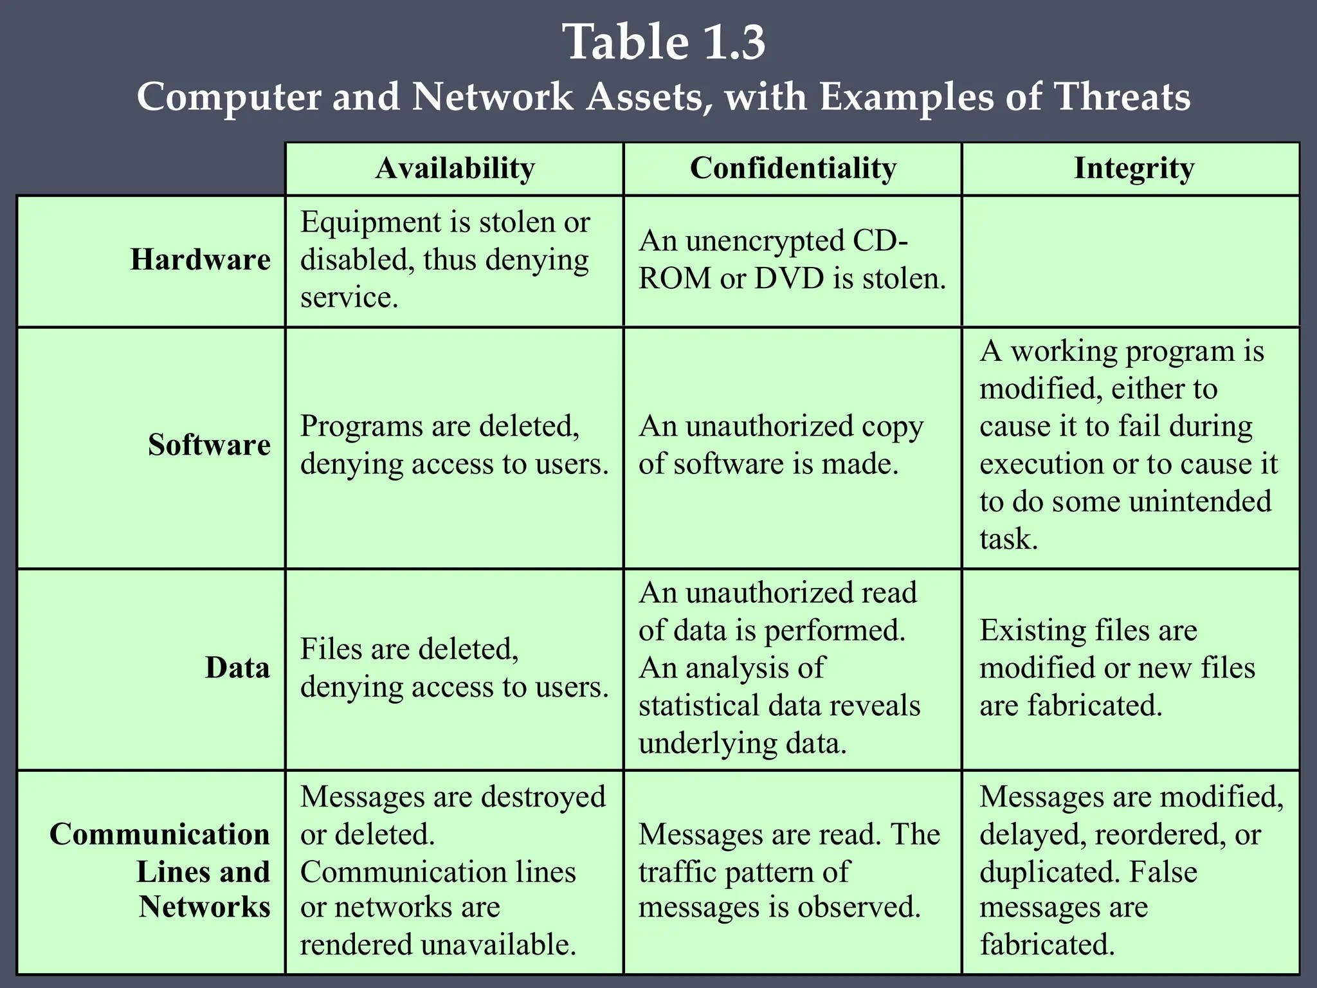

Slide 60
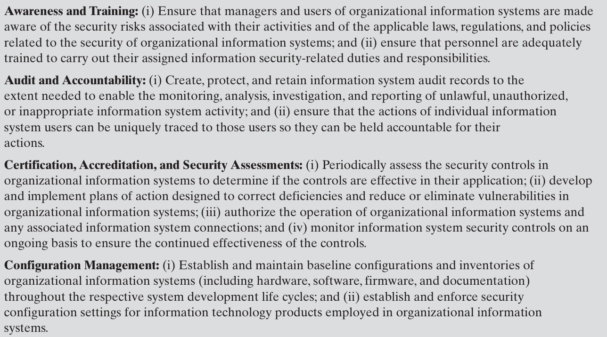
Security Functional Requirements

Slide 61
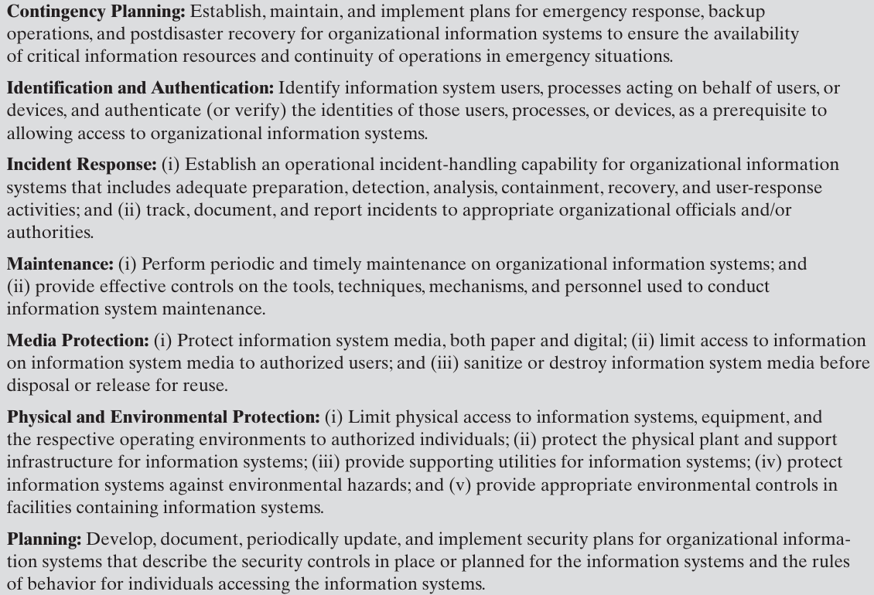
Security Functional Requirements

Slide 62
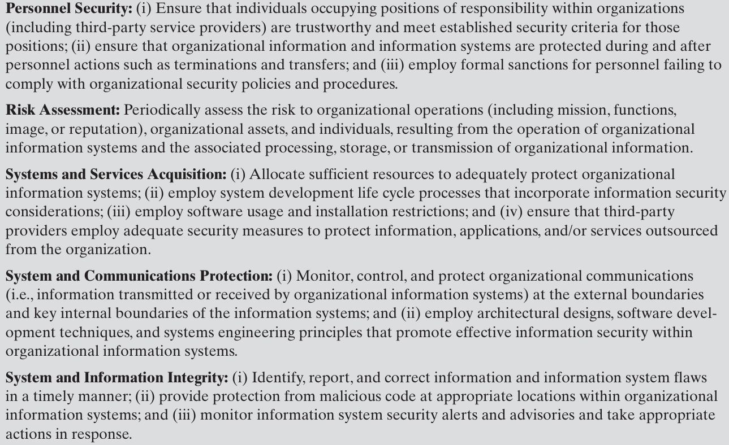
System Security Functional Requirements

Slide 63
Fundamental Security Design Principles

Slide 64
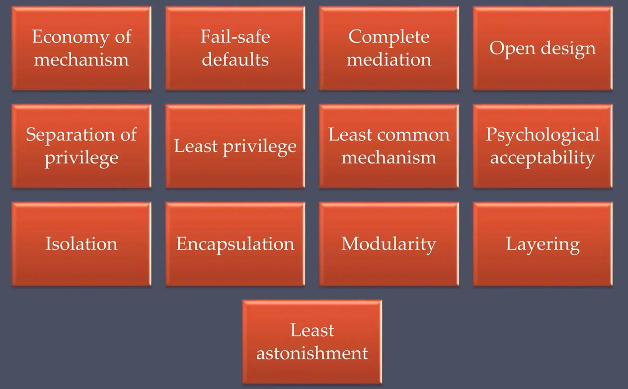
Fundamental Security Design Principles

Slide 65
Fundamental Security design Principals
■ Economy of mechanism
■ Fail-safe defaults
■ Complete mediation:Every access request must be checked for authorization.
■ Open design
■ Separation of privilege
■ Least privilege
■ Least common mechanism : Minimize shared resources between users or processes.
■ Psychological acceptability
■ Isolation
■ Encapsulation
■ Modularity
■ Layering
■ Least astonishment: System behavior should be predictable and intuitive.
The National Centers of Academic Excellence in Information Assurance/Cyber Defense, which is jointly sponsored by the U.S. National Security Agency and the U.S. Department of Homeland Security, list the following as fundamental security design principles [NCAE13]:

Slide 66
Fundamental Security design Principals
Security design principles are fundamental guidelines for building secure systems
They ensure systems are designed to prevent vulnerabilities rather than fix them later
These principles guide developers in designing robust, reliable, and secure systems

Slide 67
Fundamental Security Design Principals
Economy of Mechanism
Security design should be simple and small
Fewer components → fewer chances of errors or vulnerabilities
Simplicity makes systems easier to analyze and secure
Fail-Safe Defaults
Default access should be denied
Access is granted only when explicitly allowed
Ensures that failure or missing permission does not cause security breach

Slide 68
Fundamental Security Design Principals
Complete Mediation
Every access request must be checked every time
No caching of previous permission decisions
Ensures continuous enforcement of security policy
Open Design
Security should not depend on secrecy of system design
System design can be public
Security relies on secret keys, not hidden algorithms

Slide 69
Fundamental Security Design Principals
Separation of Privilege
Access should require multiple conditions or permissions (password + OTP)
Reduces risk of unauthorized access
Any technique in which a program is divided into parts that are limited to the specific privileges they require in order to perform a specific task.
Least Privilege
Users and programs should have minimum required permissions
Limits damage if account or process is compromised
Widely used in operating systems and networks

Slide 70
Fundamental Security Design Principals
Least Common Mechanism
Reduce sharing of resources among users
Shared mechanisms increase risk of information leakage
Isolation improves security and reduces attack surface
Psychological Acceptability
Security mechanisms should be easy to use
If too complex, users may bypass security controls
Security should not reduce usability

Slide 71
Fundamental Security Design Principals
Least Astonishment
System should behave predictably
Avoid unexpected security behavior
Reduces user and admin errors
Defense in Depth
Use multiple security layers
One failure doesn’t break system
Combine firewall, encryption, auth

Slide 72
Attack Surface and Attack Tress

Slide 73

Attack Surfaces
and Attack Trees
Systematic analysis of modern security threats.

Slide 74


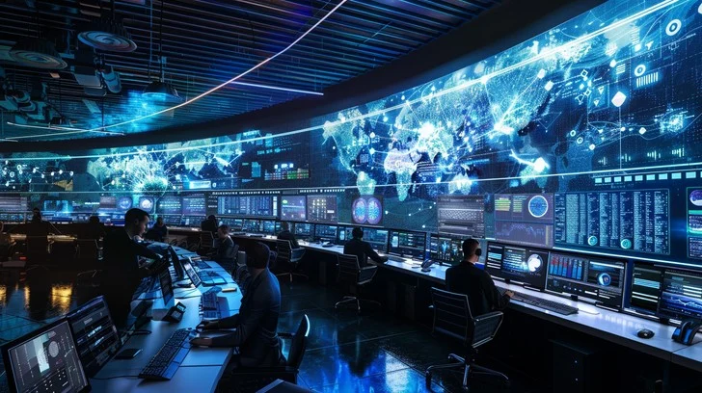

Analyzing Security Exposure
Modern systems face numerous security threats. Effective defense requires identifying every possible attack point.
The Analytic Framework
Security analysis is built on two primary concepts: Attack Surfaces (measuring where) and Attack Trees (modeling how).

Slide 75
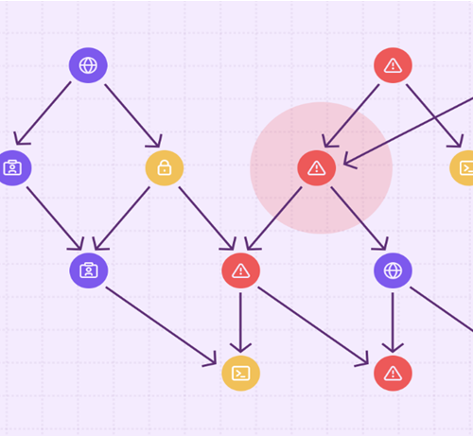
What is an Attack Surface?
The sum of all points where an attacker can try to enter or extract data from a system.
Exposure: Represents total system vulnerability.
Risk: Larger surfaces increase security risk.
Goal: Minimize entry points to reduce opportunity.

Slide 76
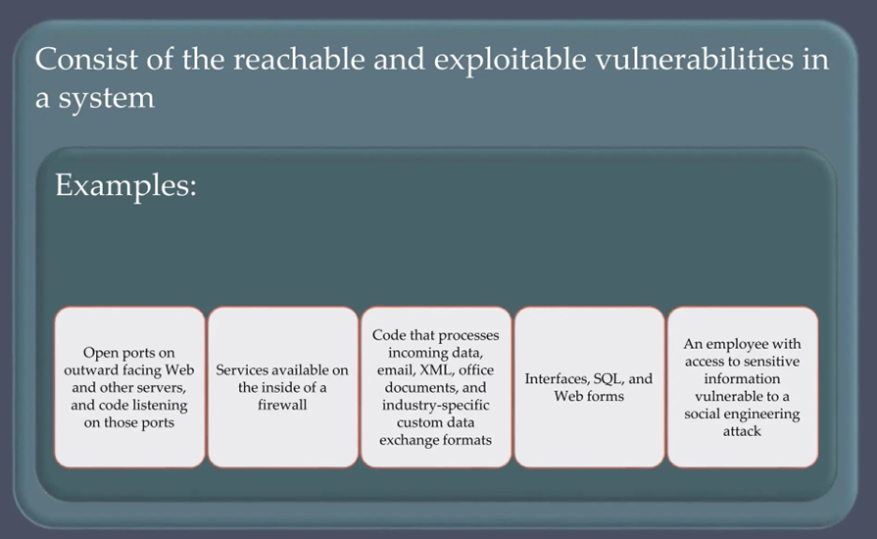
What is an Attack Surface?

Slide 77






Attack Surface Categories
Network
Software
Human
Open ports, protocols, services, and wireless access points.
Applications, OS code, APIs, and vulnerable libraries.
Users and admins, social engineering, and security awareness.

Slide 78
Asset Exposure Examples
Component | Possible Attack Method
Web Server | SQL Injection / Cross-Site Scripting
Email System | Phishing / Business Email Compromise
Open Network Port | Unauthorized Access / Exploitation
Wi-Fi Network | Eavesdropping / Packet Sniffing
Employee Account | Password Theft / Social Engineering

Slide 79
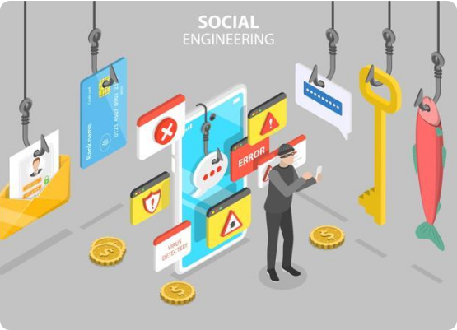
Reducing the Attack Surface
Disable unnecessary services/ports.
Apply consistent patches and updates.
Enforce strong MFA authentication.
Use firewalls & network segmentation.
Conduct awareness training.
Principle: Less Exposure = Lower Risk.

Slide 80
Attack Surface and Layering

Slide 81


Attack Trees
Modeling Adversarial Strategies and Pathways

Slide 82
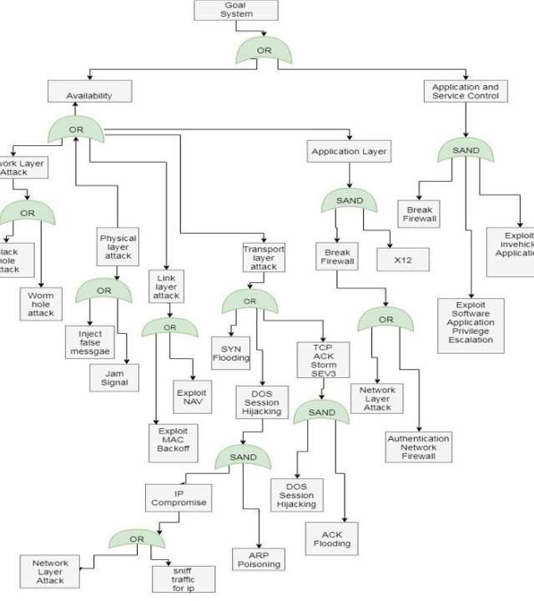

Concept: Attack Trees
A hierarchical model that describes how an attacker can achieve a specific goal.
Strategic Modeling
The root node represents the attacker's objective, while child nodes represent alternative attack paths.

Slide 83
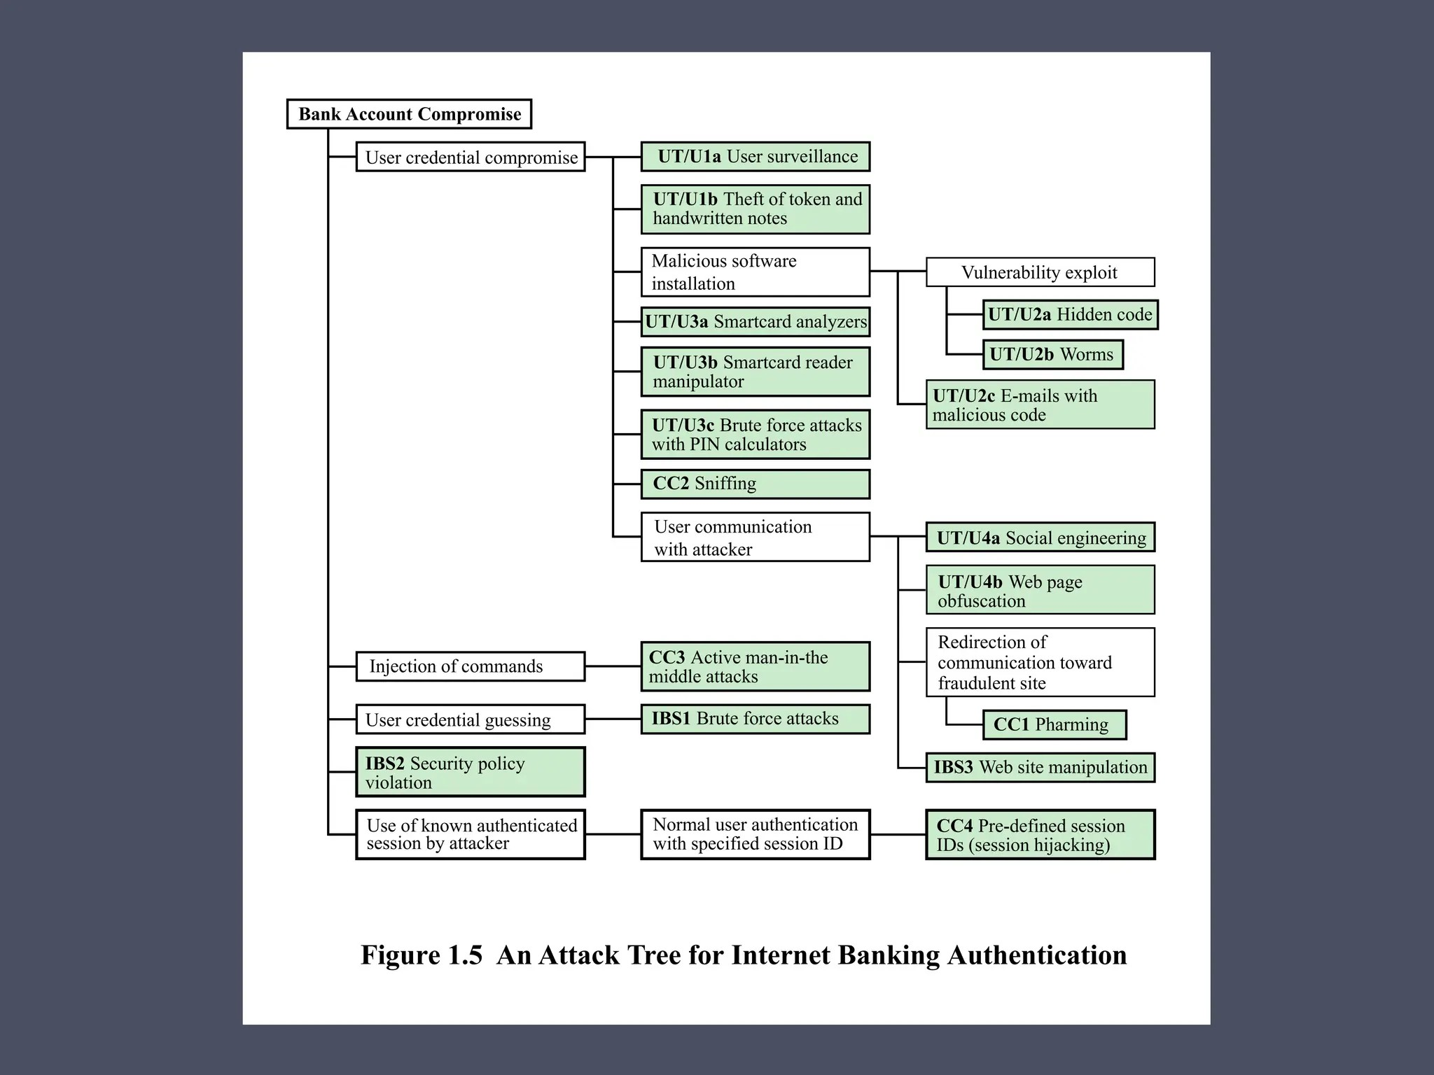
Concept:
Attack Trees
User terminal and user (UT/U): These attacks target the user equipment,
including the tokens that may be involved, such as smartcards or other password
generators, as well as the actions of the user.
• Communications channel (CC): This type of attack focuses on communication
links.
• Internet banking server (IBS): These types of attacks are offline attack against
the servers that host the Internet banking application.

Slide 84



Structure and Hierarchy
Root Node
Branches
Leaves
Represents the attacker's ultimate security objective (e.g., Steal Data).
Intermediate steps and general attack strategies to achieve the goal.
Specific, actionable attack methods (e.g., Phishing or Password Guessing).

Slide 85

Logic: AND vs OR Nodes
OR Nodes (Alternatives)
AND Nodes (Requirements)
Any one child attack can achieve the objective.
All child actions must occur together to succeed.
EX: Phishing OR Brute Force
EX: Obtain Credentials AND Bypass MFA

Slide 86
Strategic Comparison
Feature | Attack Surface | Attack Tree
Primary Focus | Identifies where attacks can occur | Identifies how attacks can occur
Metric | Measures total system exposure | Models specific attack paths
Core Element | Focuses on vulnerabilities | Focuses on adversarial strategy
Use Case | Reducing entry points | Threat analysis and risk assessment

Slide 87

Computer Security Strategy
Defining the fundamental framework for organizational security management.

Slide 88




The Strategic Framework
Computer security is not merely a technical problem; it is a management and organizational challenge.
Holistic Security
A comprehensive strategy integrates policy, technical implementation, assurance, and constant evaluation.

Slide 89






The Four Pillars of Strategy
Policy
Implementation
Assurance
Evaluation
A formal statement of rules and practices to be followed.
Technical and organizational mechanisms used to enforce policy.
Confidence that security measures work as intended.
Periodic review and testing of security effectiveness.

Slide 90

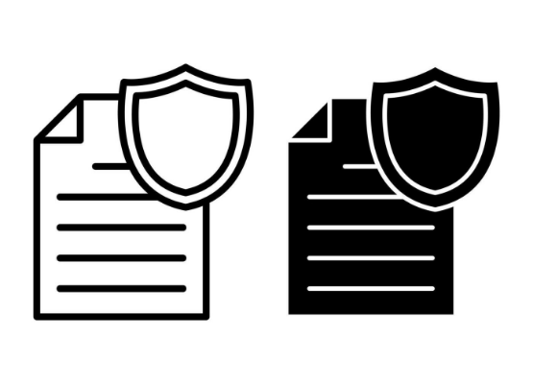
Establishing Policy
What is Permitted?
Security policy is the "law" of the system. It defines what is allowed and what is disallowed.
Asset Valuation: What needs protection?
Threat Assessment: What are the risks?
Cost-Benefit: Protection vs. Cost.

Slide 91
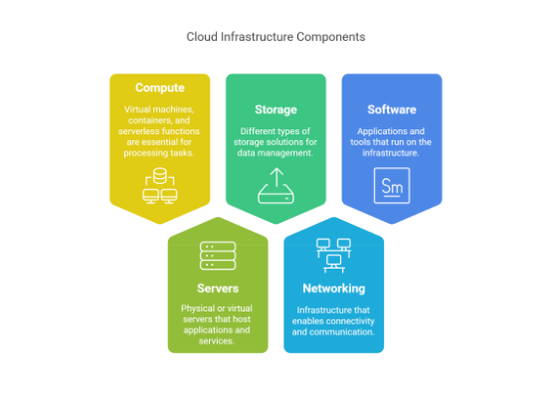
Prevention Mechanisms
Initial Defense
Prevention is the first line of strategy. It aims to block unauthorized access before it happens.
Authentication & Access Control.
Firewalls and Network Perimeter.
Encryption of sensitive data.

Slide 92




Active Monitoring
Detection
Response
Mechanisms used to identify that a security violation has been attempted or is occurring. Includes audit logs and IDSs.
Action taken once an attack is detected. Includes stopping the attack and limiting further damage to the system.

Slide 93
Restoration & Recovery
A vital part of strategy is planning for the "after-effect" of a breach.
Data Backups & Redundancy.
Business Continuity Planning.
System Integrity Checks.

Slide 94


System Assurance
Building Confidence
Assurance is the ground for believing that a system meets its security requirements.
It encompasses Design Assurance (sound architecture) and Operational Assurance (secure day-to-day use).

Slide 95
Measuring Success
Evaluation Method | Strategic Focus
Internal Auditing | Routine check of policy compliance.
Vulnerability Scanning | Technical discovery of known weaknesses.
Penetration Testing | Simulated attacks to test response effectiveness.
Certification | Formal review against standardized criteria.

Slide 96
The Reality of Risk
0%
Managing the Unavoidable
Strategy assumes that some security failure will occur. The goal is to manage risk to an acceptable level, not to reach an impossible 100% security state.
Total Security Guarantee

Slide 97
Ongoing Challenges
User Resistance: Security measures that hinder productivity are often bypassed.
Dynamic Threats: Attackers constantly evolve their techniques.
Legacy Systems: Old hardware/software lacking modern security hooks.
Resource Constraints: Balancing limited budget with maximum protection.

Slide 98

Computer Security Standards

Slide 99
The Crucial Role
of Standards
Standards are essential for interoperability and for ensuring a consistent level of security across different systems and organizations.

Slide 100


Defining Standards
Technical Precision
Global Consistency
Standards contain technical specifications or other precise criteria designed to be used consistently as a rule, guideline, or definition.
They ensure that different products and systems from different vendors can work together seamlessly while maintaining security integrity.

Slide 101






Primary Standards Bodies
NIST
ISOC
ITU-T
ISO
U.S. National Institute of Standards and Technology. Major influence on federal and global standards.
Internet Society. Focuses on the evolution and growth of the Internet through bodies like IETF.
International Telecommunication Union. Specializing in international telecom standards.
International Organization for Standardization. A global non-governmental body.

Slide 102


NIST: Federal Excellence
The US Influence
NIST is a non-regulatory agency of the U.S. Commerce Department. In the security domain, it is best known for producing:
FIPS (Federal Information Processing Standards)
SP 800 (Special Publications)
NISTIR (Interagency Reports)

Slide 103


ISOC & IETF: Internet Standards
The Voice of the Internet
The Internet Society (ISOC) oversees the Internet Engineering Task Force (IETF), which is responsible for the technical development of the Internet.
Request for Comments (RFC): The formal document series used for Internet standards, ranging from protocols to architectural guidelines.

Slide 104
ITU-T: Telecommunications
Global Connectivity
The ITU-T is a United Nations specialized agency. It develops international standards for telecommunications.
X.800 Architecture: Defines a systematic way of providing security requirements (Security Architecture for OSI).
X.509 Standard: A key standard for public-key certificates and digital signatures used globally.

Slide 105






ISO & IEC: Global Collaboration
Standardization: ISO is the world's largest developer of voluntary International Standards.
Collaboration: Works with the IEC to form Joint Technical Committees (JTC 1) for IT security.
27000 Series: The gold standard for information security management systems (ISMS).

Slide 106
NIST Publication Types
Type | Abbreviation | Primary Purpose
Federal Info. Processing Stds. | FIPS | Standards for federal systems where no voluntary standard exists.
Special Publications | SP 800 | Guidelines, recommendations, and reference data for IT security.
NIST Interagency Reports | NISTIR | Technical research and reports on security-related topics.

Slide 107
ISO 27K Impact
The 27000 Series
27k
The ISO/IEC 27000 series (also known as the 'ISMS Family of Standards') provides a comprehensive framework for managing sensitive company information so that it remains secure.
It is the most widely recognized international security management standard in the private sector.
The Standard for Management

Slide 108
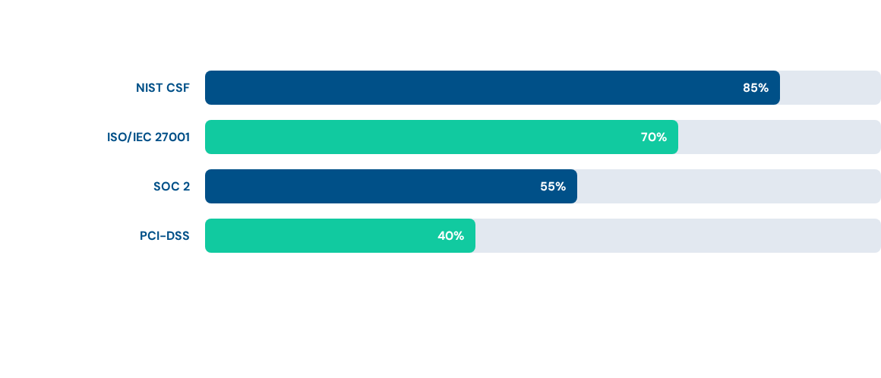
Adoption of Frameworks
Usage trends indicate a heavy reliance on NIST and ISO/IEC frameworks as the primary benchmarks for organizational security governance.

Slide 109
ITU-T
The ITU Telecommunication Standardization Sector (ITU-T) is one of the three sectors (divisions or units) of the International Telecommunication Union (ITU); it coordinates standards for telecommunications.
The ITU-T mission is to ensure the efficient and timely production of standards covering all fields of telecommunications on a worldwide basis, as well as defining tariff and accounting principles for international telecommunication services.

Slide 110
OSI
ISO- The International Organization for Standardization (French: Organisation internationale de normalisation;) produced OSI (Open Systems Interconnection Reference Model, the OSI Reference Model, or even just the OSI Model)

Slide 111
History of OSI
In the late 1970s, two projects began independently, with the same goal: to define a unifying standard for the architecture of networking systems.
One was administered by the International Organization for Standardization (ISO), while the other was undertaken by the International Telegraph and Telephone Consultative Committee, or CCITT (the abbreviation is from the French version of the name).
These two international standards bodies each developed a document that defined similar networking models. ISO 7498, ITU-T (formerly CCITT ) standard X.200 (1984)

Slide 112
X.800
X.800 Recommendation:
1. provides a general description of security services and related mechanisms, which may be provided by the Reference Model; and
2. defines the positions within the Reference Model where the services and mechanisms may be provided.
This Recommendation extends the field of application of recommendation X.200, to cover secure communications between open systems.

Slide 113
OSI Security Architecture
ITU-T Recommendation X.800, Security Architecture for OSI describes a systematic way of defining the requirements for security and characterizing the approaches to satisfying those requirements. Focus
Security attack
  Any action that compromises the security of information owned by an organization
Security mechanism
  A process (or a device incorporating such a process) that is designed to detect, prevent, or recover from a security attack
Security service
  A processing or communication service that enhances the security of the data processing systems and the information transfers of an organization
  Intended to counter security attacks, and they make use of one or more security mechanisms to provide the service

Slide 114
IETF and RFC
The Internet Engineering Task Force (IETF) (1986) develops and promotes voluntary Internet standards, in particular the standards that comprise the Internet protocol suite (TCP/IP).
A Request for Comments (RFC) is a publication of the Internet Engineering Task Force (IETF) and the Internet Society, the principal technical development and standards-setting bodies for the Internet.
The Internet Society (ISoc) is an international, non-profit organization founded in 1992 to provide leadership in Internet related standards, education, and policy.

Slide 115
ATTACKS
The three goals of security, confidentiality, integrity and availability can be threatened by security attacks.

Slide 116
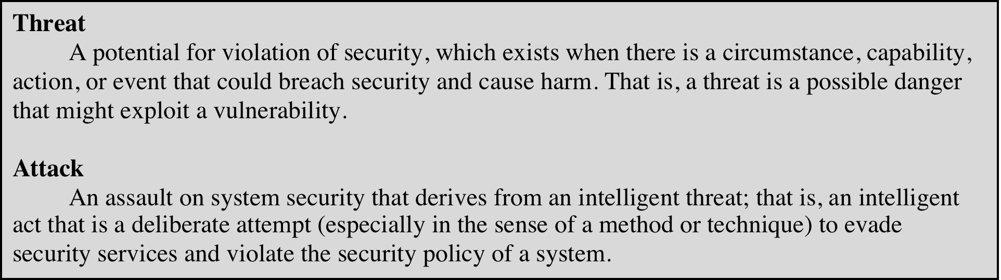
Threats and Attacks (RFC 4949)
Internet Security Glossary, Version 2
This Glossary provides definitions, abbreviations, and explanations of terminology for information system security.
Notes:
In the literature, the terms threat and attack are commonly used to mean more
or less the same thing. Table 1.1 provides definitions taken from RFC 4949, Internet
Security Glossary.

Slide 117
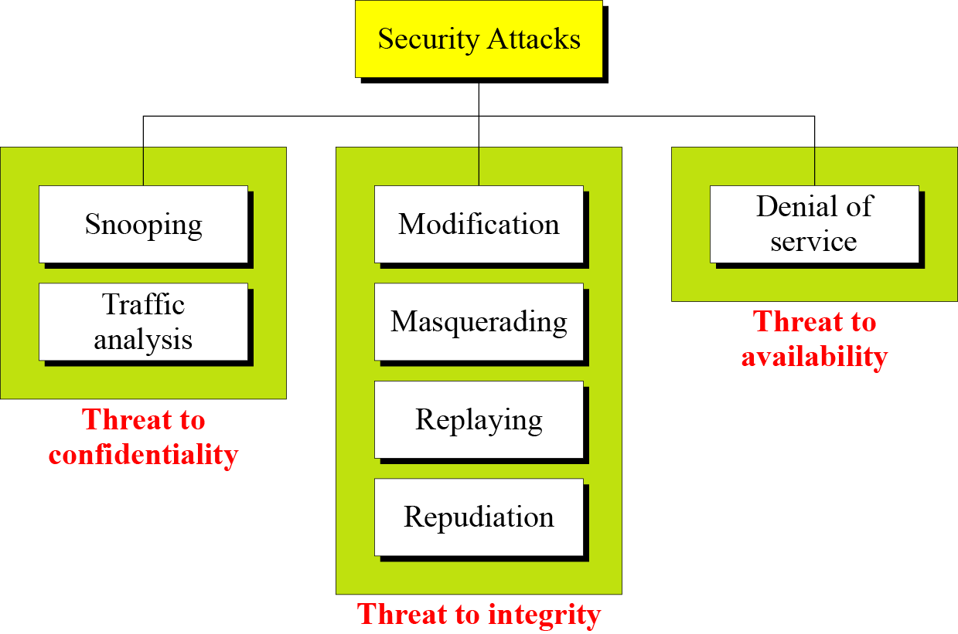

Slide 118
Security Attacks
A means of classifying security attacks, used both in X.800 and RFC 4949, is in terms of passive attacks and active attacks
A passive attack attempts to learn or make use of information from the system but does not affect system resources
An active attack attempts to alter system resources or affect their operation

Slide 119
Passive Attacks
(Two types)
Are in the nature of eavesdropping on, or monitoring of, transmissions
Goal of the opponent is to obtain information that is being transmitted
Two types of passive attacks are:
  The release of message contents
  Traffic analysis

Slide 120
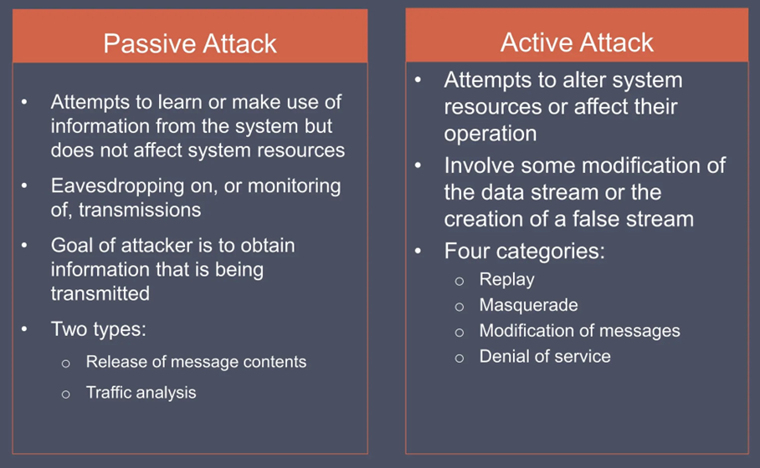

Slide 121
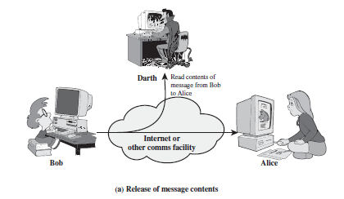
Snooping refers to unauthorized access to or interception of data.

Slide 122
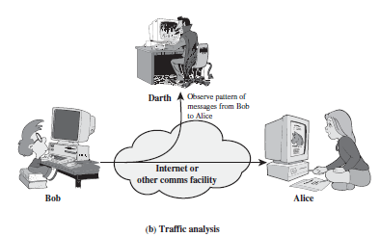
Traffic analysis refers to obtaining some other type of information by monitoring online traffic.

Slide 123
Active Attacks (4 types)
Involve some modification of the data stream or the creation of a false stream
Difficult to prevent because of the wide variety of potential physical, software, and network vulnerabilities
Goal is to detect attacks and to recover from any disruption or delays caused by them

Slide 124
Modification means that the attacker intercepts the message and changes it.
Masquerading or spoofing happens when the attacker impersonates somebody else.
Replaying means the attacker obtains a copy
of a message sent by a user and later tries to replay it.
Repudiation means that sender of the message might later deny that she has sent the message; the receiver of the message might later deny that he has received the message.

Slide 125
Denial of service (DoS) is a very common attack. It may slow down or totally interrupt the service of a system.

Slide 126
Active Attacks (4 types)
Masquerade
Takes place when one entity pretends to be a different entity
Usually includes one of the other forms of active attack
Replay
Involves the passive capture of a data unit and its subsequent retransmission to produce an unauthorized effect
Denial of service
Prevents or inhibits the normal use or management of communications facilities
Some portion of a legitimate message is altered, or messages are delayed or reordered to produce an unauthorized effect
Modification of messages

Slide 127
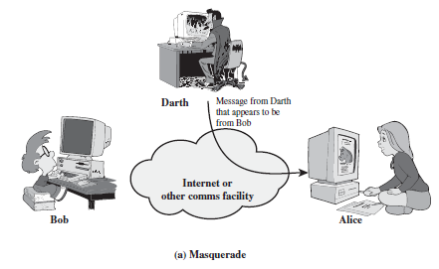
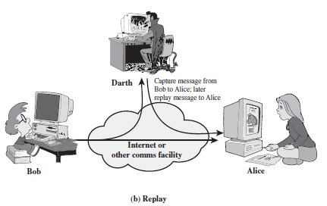

Slide 128
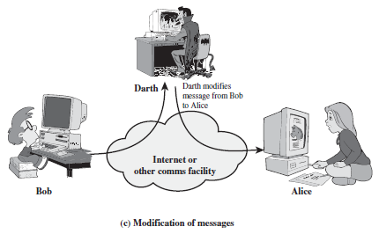
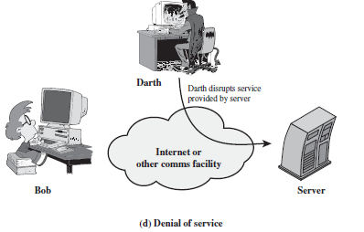

Slide 129
Security Services
to prevent or detect attacks
to enhance the security
replicate functions of physical documents
  e.g.
    have signatures, dates
    need protection from disclosure, tampering, or destruction
    notarize
    record

Slide 130
Basic Security Services
Authentication
  assurance that the communicating entity is the one it claims to be
  peer entity authentication
    mutual confidence in the identities of the parties involved in a connection
  Data-origin authentication
    assurance about the source of the received data
Access Control
  prevention of the unauthorized use of a resource
  to achieve this, each entity trying to gain access must first be identified and authenticated, so that access rights can be tailored to the individual

Slide 131
Basic Security Services
Non-Repudiation
  protection against denial by one of the parties in a communication
  Origin non-repudiation
    proof that the message was sent by the specified party
  Destination non-repudiation
    proof that the message was received by the specified party

Slide 132
Relationships
among integrity, data-origin authentication and non-repudiation
Non-repudiation
Authentication
Integrity

Slide 133
Services and Mechanisms
ITU-T provides some security services and some mechanisms to implement those services. Security services and mechanisms are closely related because a mechanism or combination of mechanisms are used to provide a service.

Slide 134
Security Services
Security service defined by X.800 as:
  A service provided by a protocol layer of communicating open systems and that ensures adequate security of the systems or of data transfers
  Defined by RFC 4949 as:
  A processing or communication service provided by a system to give a specific kind of protection to system resources

Slide 135
X.800 Service Categories
X.800 divides these services into five categories and fourteen specific services
Authentication
Access control
Data confidentiality
Data integrity
Nonrepudiation

Slide 136
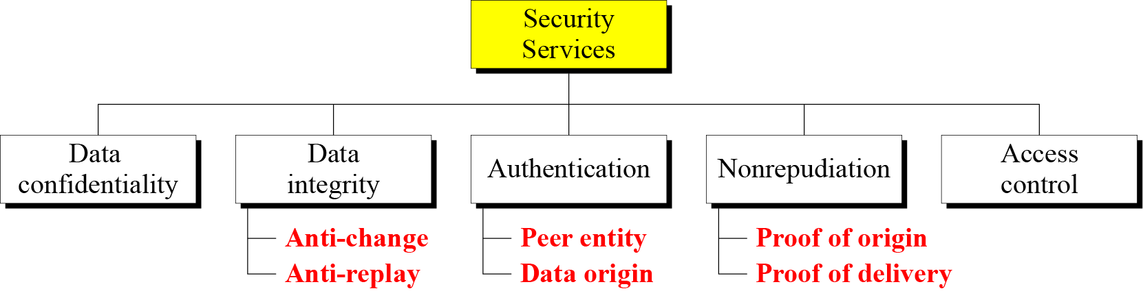

Slide 137
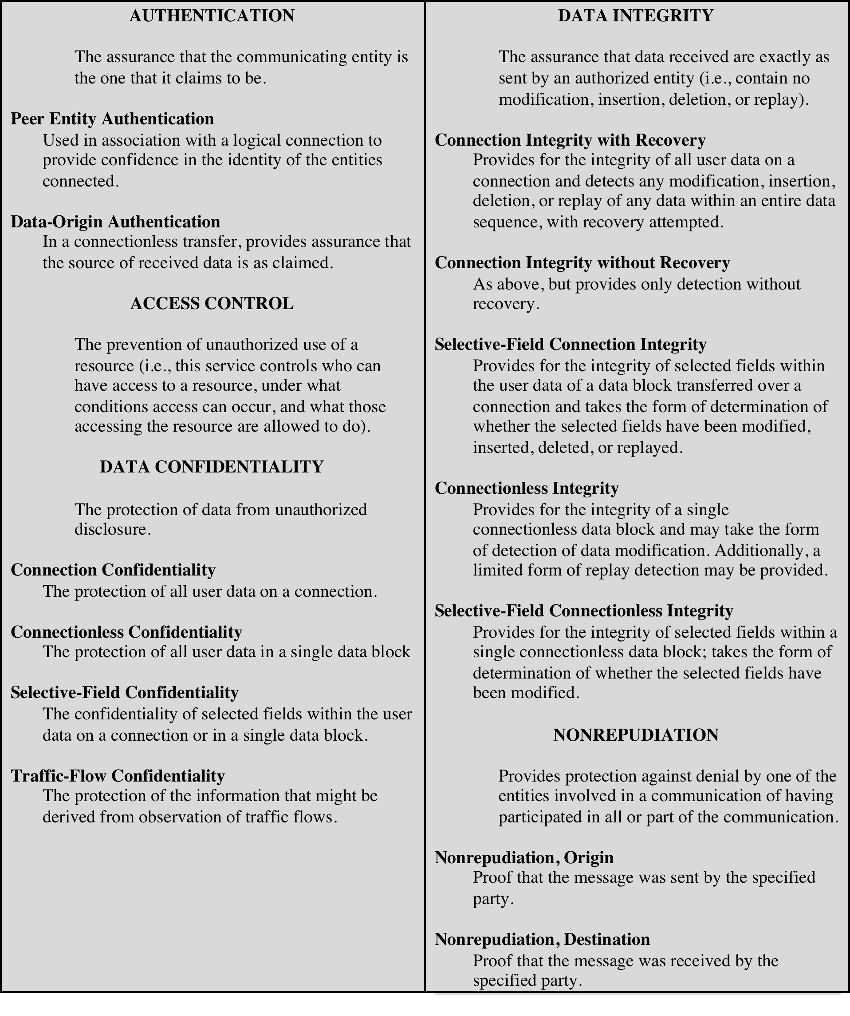
Security Services
(X.800)

Slide 138
Authentication
Concerned with assuring that a communication is authentic
  In the case of a single message, assures the recipient that the message is from the source that it claims to be from.
  In the case of ongoing interaction, assures the are authentic and that the connection is not interfered with in such a way that a third party can masquerade as one of the two legitimate parties
Two specific authentication services are defined in X.800:
Peer entity authentication
Data origin authentication
Two entities are considered peers if they implement the same protocol in different systems (e.g., two TCP modules in two communicating systems).

Slide 139
Access Control
The ability to limit and control the access to host systems and applications via communications links
To achieve this, each entity trying to gain access must first be identified, or authenticated, so that access rights can be tailored to the individual

Slide 140

Data Confidentiality
The protection of transmitted data from passive attacks
  Broadest service protects all user data transmitted between two users over a period of time
  Narrower forms of service include the protection of a single message or even specific fields within a message
The protection of traffic flow from analysis
  This requires that an attacker not be able to observe the source and destination, frequency, length, or other characteristics of the traffic on a communications facility

Slide 141
Data Integrity
Can apply to a stream of messages, a single message, or selected fields within a message
Connection-oriented integrity service deals with a stream of messages and assures that messages are received as sent with no duplication, insertion, modification, reordering, or replays
A connectionless integrity service deals with individual messages without regard to any larger context and generally provides protection against message modification only

Slide 142

Nonrepudiation
Prevents either sender or receiver from denying a transmitted message
When a message is sent, the receiver can prove that the alleged sender in fact sent the message
When a message is received, the sender can prove that the alleged receiver in fact received the message

Slide 143
Availability service
Availability
  The property of a system or a system resource being accessible and usable upon demand by an authorized system entity, according to performance specifications for the system
Availability service
  One that protects a system to ensure its availability
  Addresses the security concerns raised by denial-of-service attacks
  Depends on proper management and control of system resources

Slide 144
Security Mechanisms
Cryptographic Techniques
  will see next
Software and hardware for access limitations
  Firewalls
Intrusion Detection and Prevention Systems
Traffic Padding
  against traffic analysis
Hardware for authentication
  Smartcards, security tokens
Security Policies / Access Control
  define who has access to which resources.
Physical security
  Keep it in a safe place with limited and authorized physical access

Slide 145
Cryptographic Security Mechanisms
Encryption (a.k.a. Encipherment)
  use of mathematical algorithms to transform data into a form that is not readily intelligible
    keys are involved

Slide 146
Cryptographic Security Mechanisms
Message Digest
  similar to encryption, but one-way (recovery not possible)
  generally no keys are used
Digital Signatures and Message Authentication Codes
  Data appended to, or a cryptographic transformation of, a data unit to prove the source and the integrity of the data
Authentication Exchange
  ensure the identity of an entity by exchanging some information

Slide 147
Security Mechanisms
Notarization
  use of a trusted third party to assure certain properties of a data exchange
Timestamping
  inclusion of correct date and time within messages

Slide 148
Security Mechanisms (X.800)
Specific security mechanisms: incorporated into the appropriate protocol layer in order to provide some of the OSI security services
  Encipherment
  digital signatures
  access controls
  data integrity
  authentication exchange
  traffic padding
  routing control
  notarization

Slide 149
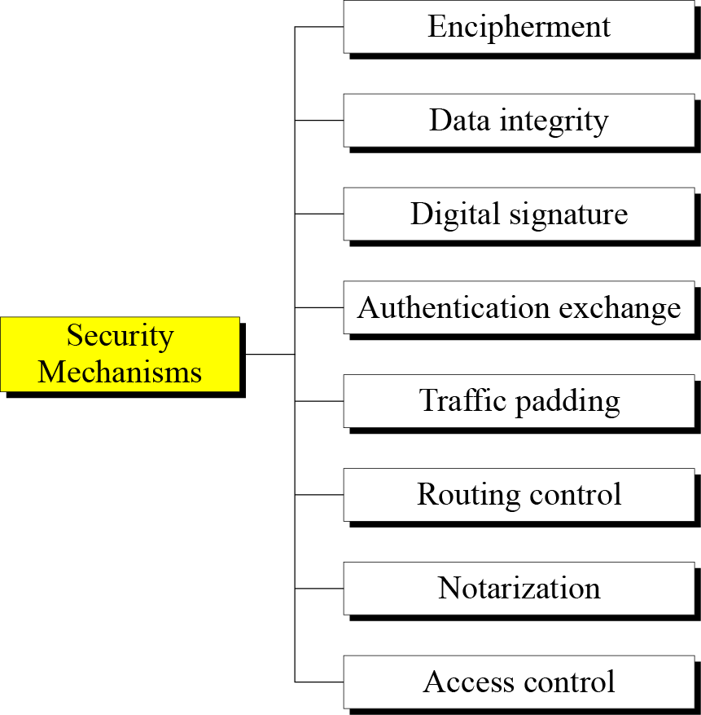

Slide 150
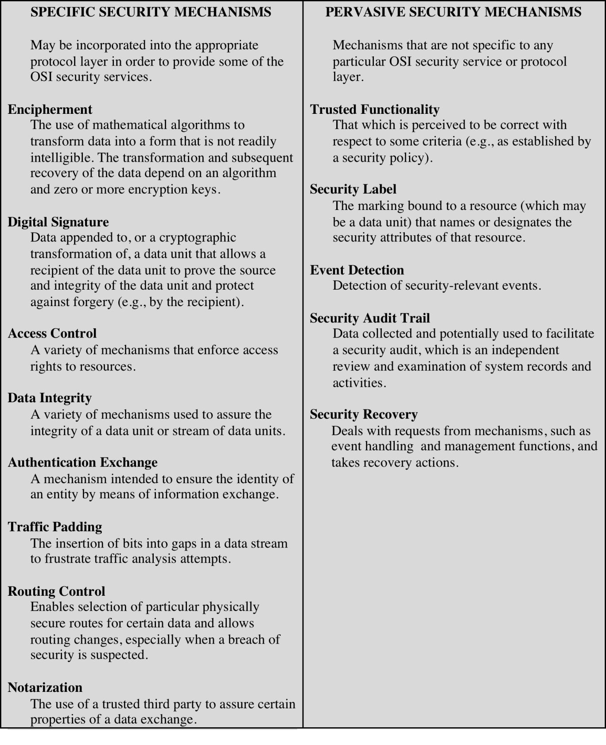
Security Mechanisms
(X.800)

Slide 151
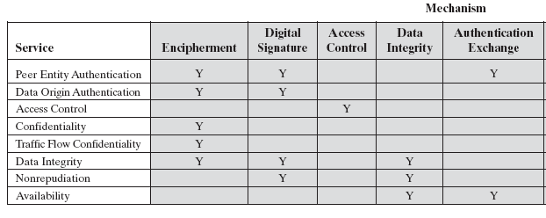
Relationship Between Security Services and Mechanisms

Slide 152
Relationship Between Security Services and Mechanisms

Slide 153
Cryptography
Cryptography is a branch of mathematics that deals with the transformation of data.
Cryptographic algorithms are used in many ways in information security and network security.
Cryptography is an essential component in the secure storage and transmission of data, and in the secure interaction between parties.

Slide 154
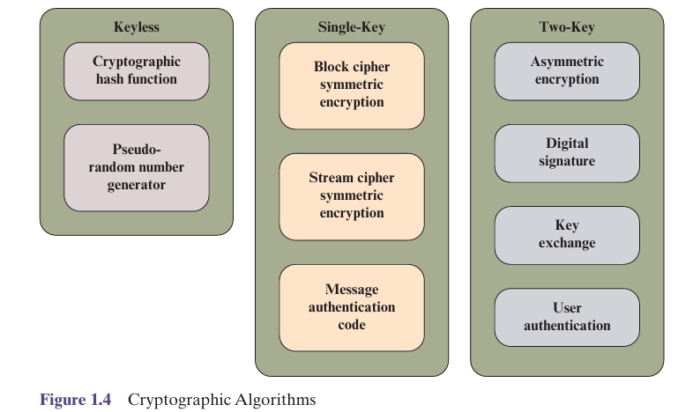
Cryptographic Algorithms

Slide 155
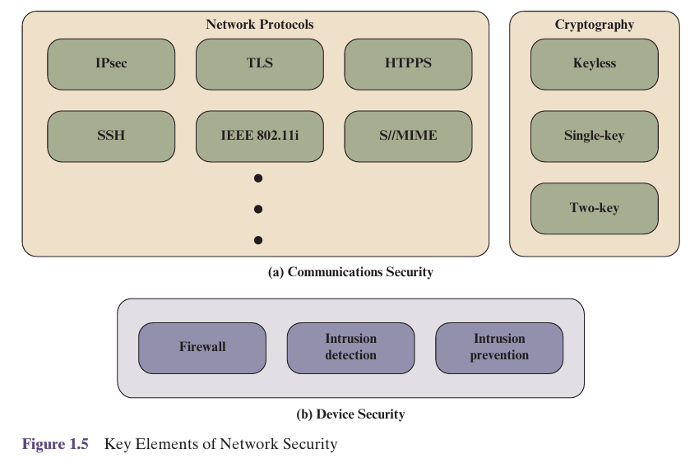
Network Security

Slide 156
Attack Surface Categories
Network attack surface
  Refers to vulnerabilities over an enterprise network, wide-area network, or the Internet
    E.g. DoS, intruders exploiting network protocol vulnerabilities
Software attack surface
  Refers to vulnerabilities in application, utility, or operating system code
Human attack surface
  Refers to vulnerabilities created by personnel or outsiders
  E.g. social engineering, insider traitors
Notes:
Attack surfaces can be categorized as follows:
■ Network attack surface: This category refers to vulnerabilities over an enterprise
network, wide-area network, or the Internet. Included in this category are network
protocol vulnerabilities, such as those used for a denial-of-service attack,
disruption of communications links, and various forms of intruder attacks.
■ Software attack surface: This refers to vulnerabilities in application, utility,
or operating system code. A particular focus in this category is Web server
Software.
■ Human attack surface: This category refers to vulnerabilities created by
personnel or outsiders, such as social engineering, human error, and trusted
insiders.

Slide 157

Defence in Depth and Attack Surface
Notes:
Attack surfaces can be categorized as follows:
■ Network attack surface: This category refers to vulnerabilities over an enterprise
network, wide-area network, or the Internet. Included in this category are network
protocol vulnerabilities, such as those used for a denial-of-service attack,
disruption of communications links, and various forms of intruder attacks.
■ Software attack surface: This refers to vulnerabilities in application, utility,
or operating system code. A particular focus in this category is Web server
Software.
■ Human attack surface: This category refers to vulnerabilities created by
personnel or outsiders, such as social engineering, human error, and trusted
insiders.

Slide 158

Attack Tree
Notes:
Attack surfaces can be categorized as follows:
■ Network attack surface: This category refers to vulnerabilities over an enterprise
network, wide-area network, or the Internet. Included in this category are network
protocol vulnerabilities, such as those used for a denial-of-service attack,
disruption of communications links, and various forms of intruder attacks.
■ Software attack surface: This refers to vulnerabilities in application, utility,
or operating system code. A particular focus in this category is Web server
Software.
■ Human attack surface: This category refers to vulnerabilities created by
personnel or outsiders, such as social engineering, human error, and trusted
insiders.

Slide 159
Unwanted Access
Placement in a computer system of logic that exploits vulnerabilities in the system and that can affect application programs as well as utility programs
Programs can present two kinds of threats:
Information access threats
Intercept or modify data on behalf of users who should not have access to that data
Service threats
Exploit service flaws in computers to inhibit use by legitimate users

Slide 160
Standards
NIST
ISOC
National Institute of Standards and Technology
U.S. federal agency that deals with measurement science, standards, and technology related to U.S. government use and to the promotion of U.S. private-sector innovation
NIST Federal Information Processing Standards (FIPS) and Special Publications (SP) have a worldwide impact
Internet Society
Professional membership society with worldwide organizational and individual membership
Provides leadership in addressing issues that confront the future of the Internet
Is the organization home for the groups responsible for Internet infrastructure standards, including the Internet Engineering Task Force (IETF) and the Internet Architecture Board (IAB)
Internet standards and related specifications are published as Requests for Comments (RFCs)

Slide 161
Techniques
Mechanisms discussed already are only theoretical recipes to implement security. The actual implementation of security goals needs some techniques. Two techniques are prevalent today: cryptography and steganography.

Slide 162
Cryptography
Cryptography, a word with Greek origins, means “secret writing.” However, we use the term to refer to the science and art of transforming messages to make them secure and immune to attacks.

Slide 163

Steganography
The word steganography, with origin in Greek, means “covered writing,” in contrast with cryptography, which means “secret writing.”
Example: covering data with text

Slide 164
Example: using dictionary
Example: covering data under color image

Slide 165
Cryptographic Services
Cryptography supports the following services:
Confidentiality
2. Integrity
3. Authentication
4. Identity
5. Timeliness
6. Proof of ownership
Each has various different requirements in different circumstances, and each issupported by a wide variety of schemes.

Slide 166
Applications
1. Communications (encryption or authentication)
2. File and data base security
3. Electronic funds transfer
4. Electronic Commerce
5. Digital cash
6. Contract signing
7. Electronic mail
8. Authentication: Passwords, PINs
9. Secure identification, Access control
10. Secure protocols
11. Proof of knowledge

Slide 167
Applications (cont.)
12. Construction by collaborating parties (secret sharing)
13. Copyright protection
14. etc.

Slide 168
Some Other Security Facts
Not as simple as it might first appear to the novice
Must consider all potential attacks when designing a system
Generally yields complex and counterintuitive systems
Battle of intelligent strategies between attacker and admin
Requires regular monitoring
Not considered as a beneficial investment until a security failure occurs
  Actually security investments must be considered as insurance against attacks
too often an afterthought
  Not only from investment point of view, but also from design point of view

Slide 169
Summary
Computer security concepts
  Definition
  Examples
  Challenges
The OSI security architecture
Security attacks
  Passive attacks
  Active attacks
Security services
  Authentication
  Access control
  Data confidentiality
  Data integrity
  Nonrepudiation
  Availability service
Security mechanisms
Model for network security
Standards
Notes:
Chapter 1 summary.

